Slide 1
Cerebras SDK on Neocortex
PSC Neocortex Webinar
12/06/2024
Leighton Wilson
leighton.wilson@cerebras.net

Slide 2
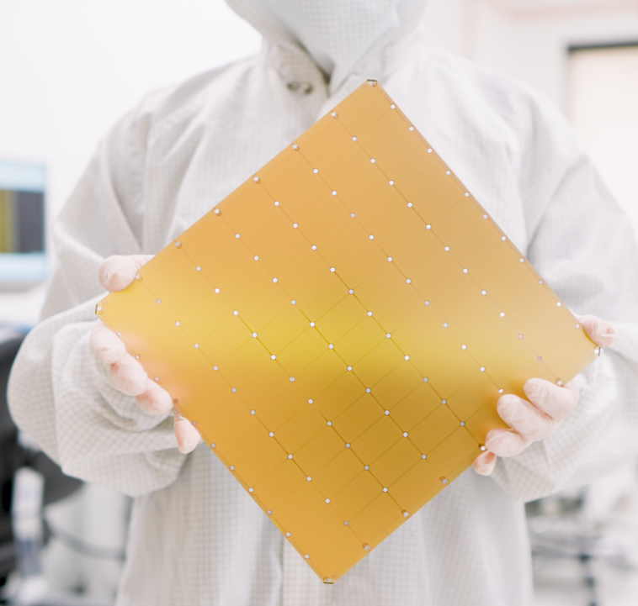
Cerebras
Wafer-Scale Engine 2
The (2nd) fastest AI chip on earth
2.6 trillion transistors
46,225 mm2 silicon
850,000 cores optimized for sparse linear algebra
7nm TSMC process
40 Gigabytes of on-chip memory
20 PByte/s memory bandwidth
220 Pbit/s fabric bandwidth
Notes:
No source
Pink on black background
Find a different image of the wafer
The traditional way to ampflity Moore’s law is to make larger chips.
So we did that. But we took it to the extreme.
This is the Wafer-Scale Engine-2, the WSE-2,
It’s currently generally available and being used by our customers every day
It’s the largest chip ever built, at 56 times larger than the largest GPU today
At over 46 thousand square millimeters in size
With 2.6 trillion transistors on a single chip,
We can fit 850,000 cores
With all of these cores integrated on a single piece silicon, we get some truly mind-boggling numbers for memory and fabric performance
Because everything is on-chip

Slide 3
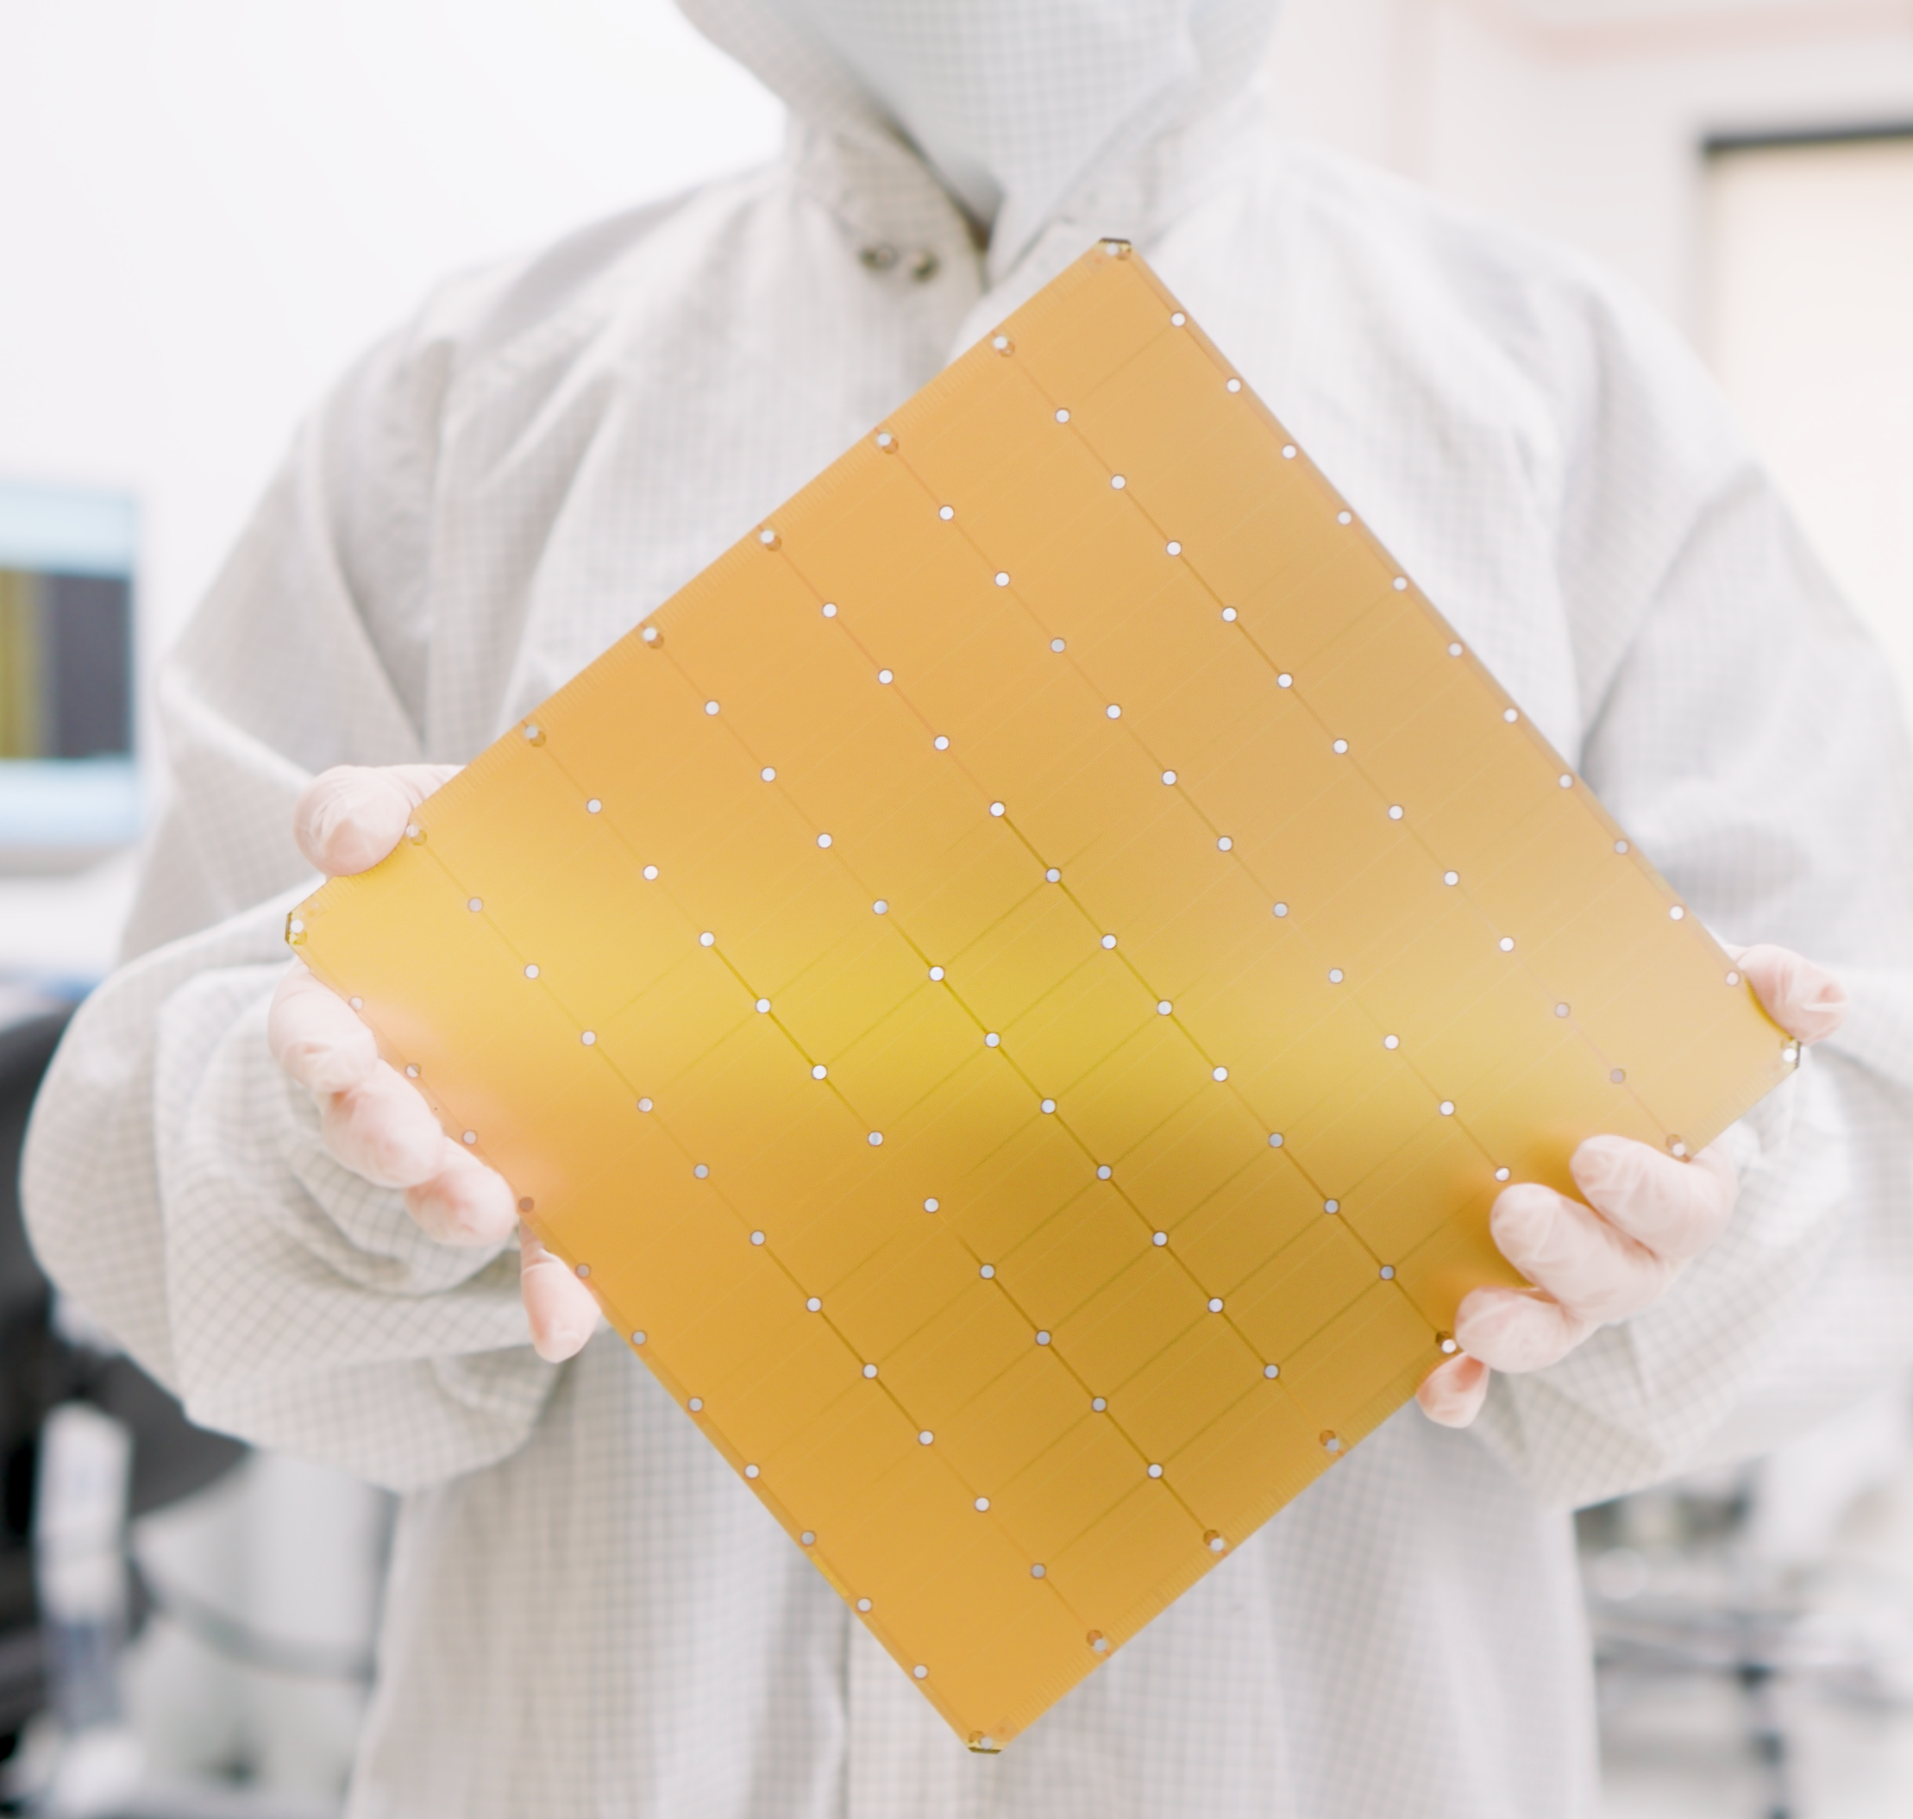
Cerebras
Wafer-Scale Engine 3
The fastest AI chip on earth again
4 trillion transistors
46,225 mm2 silicon
900,000 cores optimized for sparse linear algebra
5nm TSMC process
125 Petaflops of AI compute
44 Gigabytes of on-chip memory
24 PByte/s memory bandwidth
245 Pbit/s fabric bandwidth
Notes:
Now, the good stuff. This is our third generation Wafer Scale Engine or WSE-3.
Larger than a GPU by more than a factor of 50.
This is 46,000 square milimeters of silicon, the largest square than you can cut out of a single wafer.
With 900,000 cores, 125 petaflops of AI compute, 44 GB of on-chip memory (which you can think of as like L1 cache), and 1000s of times more memory and fabric bandwidth than a GPU, we enable our customers to tackle their largest AI problems in a fraction of the time.

Slide 4
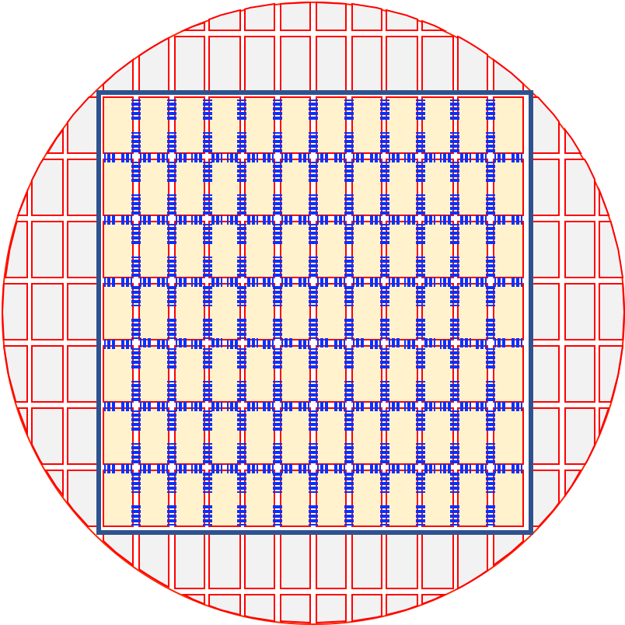
Does your application scale poorly across nodes?
Examples: FFT-based solvers, particle simulators, non-linear problems with iterative solvers
The Cerebras solution:
The WSE-2 has a fabric that is high bandwidth and low-latency, allowing for excellent parallel efficiency for non-linear and highly communicative codes
The CS-2 system has 850k cores and can fit problems on an individual chip that take tens to hundreds of traditional small compute nodes.
  Each core is individually programmable
Notes:
As we have talked about, we built the Cerebras systems to overcome some of the common constraints for AI and HPC problems. I want to illustrate how a wafer can improve your time-to-solution for problems that are currently bottlenecked. First, are you suffering from poor scaling? Many applications have algorithmic scaling issues that arise because of the amount of communication that needs to happen, or the regularity of the communication. The Cerebras system is built for communication. The fabric allows for core-to-core communication that is high bandwidth and low latency. Not just that, but this fabric connects 850 thousand cores together, all of which can pass data to a neighbor in a single cycle. Our system can be programmed in blocks, or programmed where each core has a unique instruction set. The number of processing elements combined with the ability to pass data quickly allows us to tackle problems where all-to-all communication is required or where the cores have to pass data every cycle incredibly well.

Slide 5
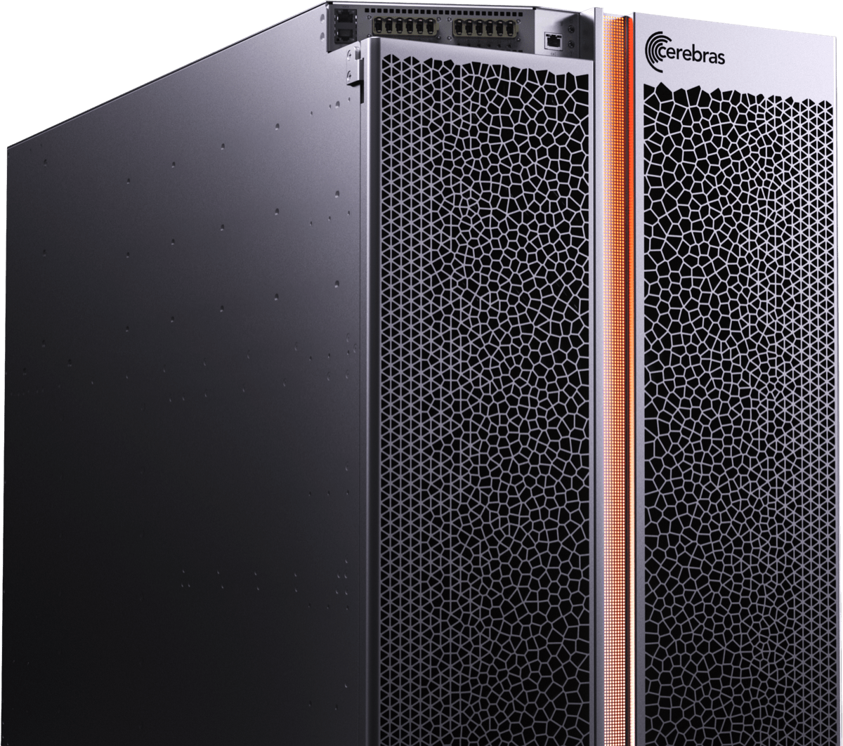
Is your application constrained by data access?
Examples: Stencil based PDE solvers, linear algebra solvers, signal processing, sparse tensor math, big data analysis
The Cerebras solution:
The CS-2 system has 40 GB of SRAM uniformly distributed across the wafer that is 1 cycle away from the processing element
  Speeds up memory access by orders of magnitude
The CS-2 system is capable of 1.2 Tb/s bandwidth onto the chip
  Stream data onto the chip as required
Notes:
Another group of applications that have been able to be accelerated are those that are constrained by data access. This constraint acts locally – how fast memory can be read into the registers on each core, as well as globally, how fast we can feed the system with data. The CS-2 c system an do both of these things incredibly well. On the wafer itself, we have 40 GB of sram that is uniformly distributed across all of our cores. Each core has access to it’s own private memory pool and memory can be put in the register in a single cycle. This allows for dramatic speed-up of any problem where your cache size or cache speed become a limiting factor. Additionally, our CS-2 system can be connected to external systems and is able to pass data onto the chip incredibly quickly. If you are streaming data and doing analysis on the fly, or if your problem is large enough that you would feed in portions of the data at a time, the wafer scale engine can handle that, and do it well. Many applications will see their times-to-completion go down by more than an order of magnitude, and we can enable system sizes that were untenable on standard hardware.

Slide 6
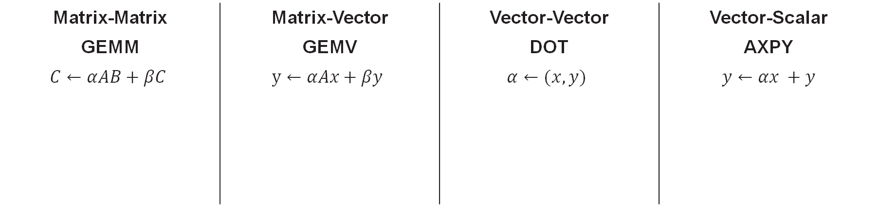

Full Performance on All BLAS Levels
Massive bandwidth jump!
Cerebras
GPU
0.005 Byte/FLOP
1 Byte/FLOP
2 Byte/FLOP
3 Byte/FLOP
Matrix-Matrix | Matrix-Vector | Vector-Vector | Vector-Scalar
GEMM | GEMV | DOT | AXPY
$$C←αAB+βC$$ | $$y←αAx+βy$$ | $$α←(x, y)$$ | $$y←αx +y$$
C
+=
A
B
y
+=
A
x
+=
y
x
y
+=
x
$$α$$
$$α$$
Notes:
With full memory bandwidth, we can run matrix operations at full performance, across all BLAS levels
Traditional architectures, with low memory bandwidth, are restricted to running only GEMMs at full performance, that’s matrix-matrix multiplies only.
In fact, you can see that any BLAS level below full Matrix-Matrix multiply requires a massive jump in memory bandwidth not possible in traditional architectures
But with enough bandwidth, you enable full performance all the way down to AXPY, which is a vector-scalar multiply.
[click]
And that’s important because a sparse GEMM is just a collection of AXPY operations, one operation for every non-zero element
With this capability, it’s possible to accelerate any sparse matrix multiply even for completely arbitrary unstructured sparsity

Slide 7
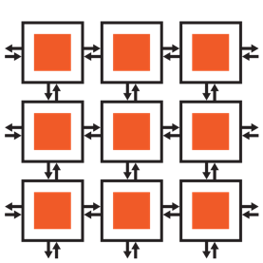
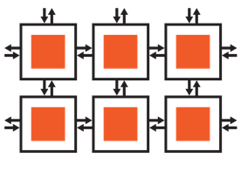
WSE-2 Architecture Basics
…
The WSE appears as a logical 2D array of individually programmable Processing Elements
Flexible compute
850,000 general purpose CPUs
16- and 32-bit native FP and integer data types
Dataflow programming: Tasks are activated or triggered by the arrival of data packets
Flexible communication
Programmable router
Static or dynamic routes (colors)
Data packets (wavelets) passed between PEs
1 cycle for PE-to-PE communication
Fast memory
40GB on-chip SRAM
Data and instructions
1 cycle read/write
…
Tensors
…
Tensors
…
…
…
…
…
…
…
…
PE
Fabric router
Offramp
Onramp
Processor
Memory
Notes:
So when programming for dataflow on the CS-2 device, you’ll write code for groups of cores, otherwise known as Processing Elements, or PEs
There are up to 850k PEs arranged in a 2D grid that you can individually program with the SDK
To program each PE, there are three main concepts you need to wrap your head around
The first is compute.
Each PE contains a general purpose processor with optimized vector instructions and native single and half precision data types
Programmed with a dataflow style of programming
The second concept is communication.
Each PE contains a programmable router which can be statically or dynamically configured to route data to neighboring Pes
Routes are known as colors
Data is routed between PEs in 32-bit packets, known as wavelets
And those wavelets can move between adjacent PEs in a single cycle
The last concept is memory.
There is a total of 40 gigabytes of on-chip SRAM memory, distributed across all PEs
Each PE has access to 48 kilobytes of local memory containing both data and instruction memory
And each read or write to local memory take only 1 cycle

Slide 8
Flexible Compute
…
Dataflow Execution Model
  Tasks may be triggered by wavelets or activated
  Each color activates a distinct task
Independent programs specified for regions of PEs
  Programs specify computation for the processor and communication via colors
  Parametrized programs allow execution of different control flow on different PEs
Asynchronous operations performed by launching microthreads
Control flow is straightforward to reason about
  Tasks are non-preemptive
  Instruction to activate another task enable state-machine behavior
…
Tensors
…
Tensors
…
…
…
…
…
…
…
…
PE
Fabric router
Offramp
Onramp
Processor
Memory
Notes:
Programmer thinks of programming regions of PEs on the device
CPU: Programmable writing CSL code for this. Called the processor in the diagram

Slide 9
Flexible Communication
PEs communicate to adjacent PEs and their processor through their routers
The router is a 24-entry table on each PE associating colors with directions
  Table entries mapped to PE memory
  Up to 24 routes (i.e. colors) may be specified at compile-time for each PE
Complex communication patterns
  Dynamic updating of routes at runtime
  Multiple routing table entries per color enable multicast: broadcasting data in multiple directions at once each cycle
Input/ output queues in each PE alleviate back pressure at routers during runtime
Programmer feeds tensors into the fabric from outside world, specified in host program
PE Routing Table
Resulting Routes
North
✓
N
✓
E
East
Direction
✓
S
W
Leads to…
✓
R
South
Ramp
Colors (24 possible)
Router-to-router communication: 1 cycle
Router-to-processor communication: 7 cycles
Notes:
Routes specified by programmer may be updated at runtime to facilitate complex communication patterns
Communication link between PEs is time-shared by different colors; this is abstracted from the programmer

Slide 10
Fast Memory
40GB of on-chip SRAM
  Uniformly distributed on wafer
  48kB per PE
Programmer can read/write memory for regions of PEs at once from host
Local PE memory is not directly addressable by other PEs, but is directly addressable by host program
SIMD possible for vector instructions
PE
Fabric router
Offramp
Onramp
Processor
Memory
PE local memory read-write: 1 cycle

Slide 11
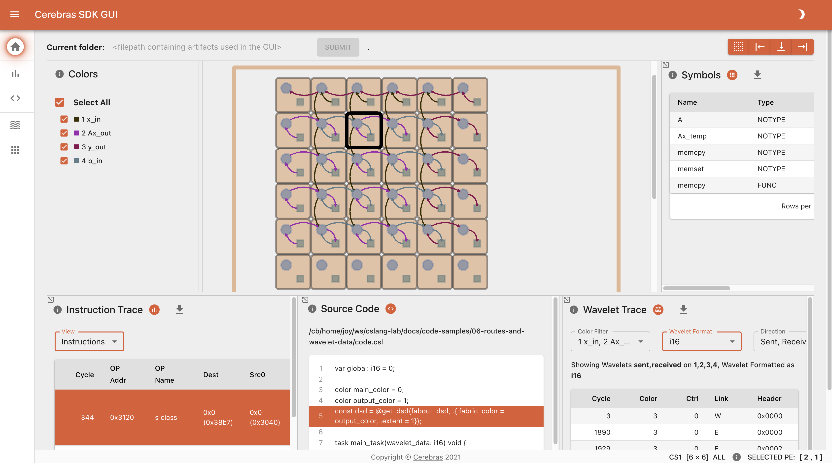
Cerebras SDK
A general-purpose parallel-computing platform and API allowing software developers to write custom programs (“kernels”) for Cerebras systems.
Language
CSL: Cerebras Software Language
Host APIs with Python
Libraries
Optimized primitives
Tools
Simulator
Debugger
Visualization
Notes:
Libraries are constantly evolving—working with customers to develop our libraries is extremely important
(RNG, memcpy)

Slide 12
SDK Components
Layout
PE Programming
Runtime
CSL layout blocks
CSL
SDK Runtime
Top level CSL layout file with set_tile_code, set_color_config calls
Define code that runs on PE, e.g. tasks
Use memcpy to copy data to/ from device, launch kernels

Slide 13



From a Programmer’s Perspective
Host CPU(s): Python
Device: CSL
Loads program onto simulator or CS-2 system
Streams in/out data from one or more workers
Reads/writes device memory
Target software simulator or CS-2
CSL programs run on groups of cores on the WSE, specified by programmer
Executes dataflow programs
Device Read/Write
Memory I/O + Data Streams
Notes:
From the user’s perspective, Programming the CS-2 looks like most accelerators
You have a host, which loads programs onto the device, streams in and out data from worker CPUs, and reads or writes to device memory
The device can either be simulated in software, or you can run on real CS-2 hardware
On the device, you write one or more C-level programs using the CSL programming language which target groups of cores on the chip
And the main execution style for the cores on the device is dataflow programs

Slide 14
CSL: Language Basics
Types
Functions
Control structures
Structs/Unions/Enums
Comptime
Builtins
Module system
Params
Tasks
Data Structure Descriptors
Layout specification
Straight from C
(via Zig)
Used for writing device kernel code
Familiar to C/C++/HPC programmers
CSL specific
Notes:
When programming the CS-2 device, you’ll leverage our new CSL programming language
CSL contains common constructs familiar to most programmers and CSL-specific constructs
We’ll cover what some of these look like,
But most users who have written C or C++ should be very comfortable using CSL

Slide 15
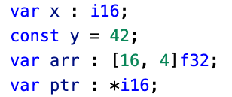
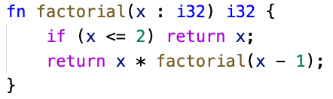
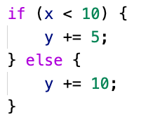
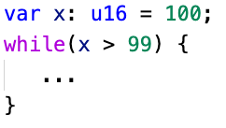
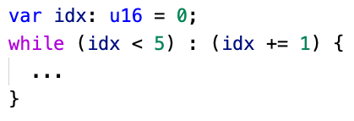
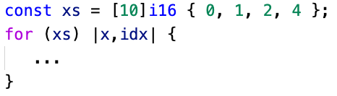
Familiar Features
Types
Syntax similar to other modern languages – Go, Swift, Scala, Rust
Float (f16, f32), signed (i16, i32), unsigned (u16, u32), boolean (bool)
Functions
Zig-style syntax
Pass by value or reference and inlining automatically handled
Control Structures
Traditional control flow: if, for, while, with zig and C style syntax
while loop
while loop with iterator
range for loop
(also provides C-style for)
conditionals

Slide 16
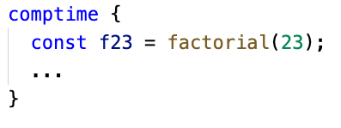
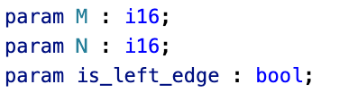
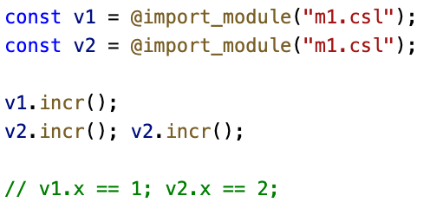
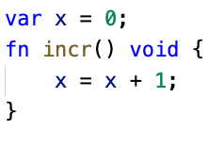
Quality of Life Features
Comptime
From Zig, block of code where all evaluation occurs at compile time
Useful for frontloading computation to avoid runtime overhead
Params
Like #define, but strongly typed
Have to be “bound” completely during compilation
Modules
Any CSL source code file is a “Module,” importable into other modules
Imported modules acts as an instance of a unique struct type
Multiple imports of the same module allowed
p1.csl
m1.csl

Slide 17
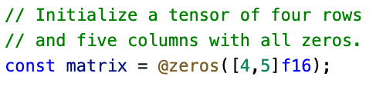
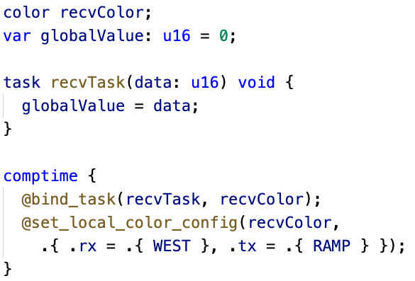
Performance Features
Builtins
Similar to function calls with @ in front of function name
Language extensions without special syntax
Used for invoking special compiler functionality
Tasks
Core building blocks of CSL
Special functions used to implement dataflow programs
Triggered by incoming wavelets on a specific color
var

Slide 18
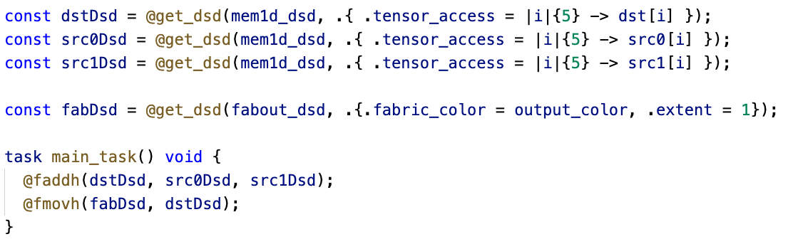
Performance Features
Data Structure Descriptors (DSDs)
Provide a mechanism to consider an array, and an access pattern, as a complete unit
Operations using DSDs run for multiple cycles to complete an instruction on all data referenced by the DSD
Performance and ease of use: lifts level of program to talking about whole structures, while lowering cost of computing indexing into hardware
DSDs are a unifying concept that provides for complex memory reads and writes and fabric reads and writes

Slide 19
SDK Example Programs Available
Repository: github.com/Cerebras/csl-examples
Introductory Tutorials
GEMV
GEMM
Cholesky Decomposition
1D and 2D FFT
7-Point Stencil SpMV
Power Method
Conjugate Gradient
Preconditioned Conjugate Gradient
Finite Difference Stencil Computations
Mandelbrot Set Generator
Shift-Add Multiplication
Hypersparse SpMV
Histogram Computation

Slide 20


SDK Access
Available on PSC Neocortex!
Get local access to the SDK simulator!
Release announcements: cerebras.net/developers/sdk-request
Documentation: sdk.cerebras.net
Join the Cerebras Developer Community
Forums at discourse.cerebras.net
View our public SDK examples GitHub repository
See github.com/Cerebras/csl-examples
Questions? developer@cerebras.net
discourse.cerebras.net
cerebras.net/developers/sdk-request

Slide 21
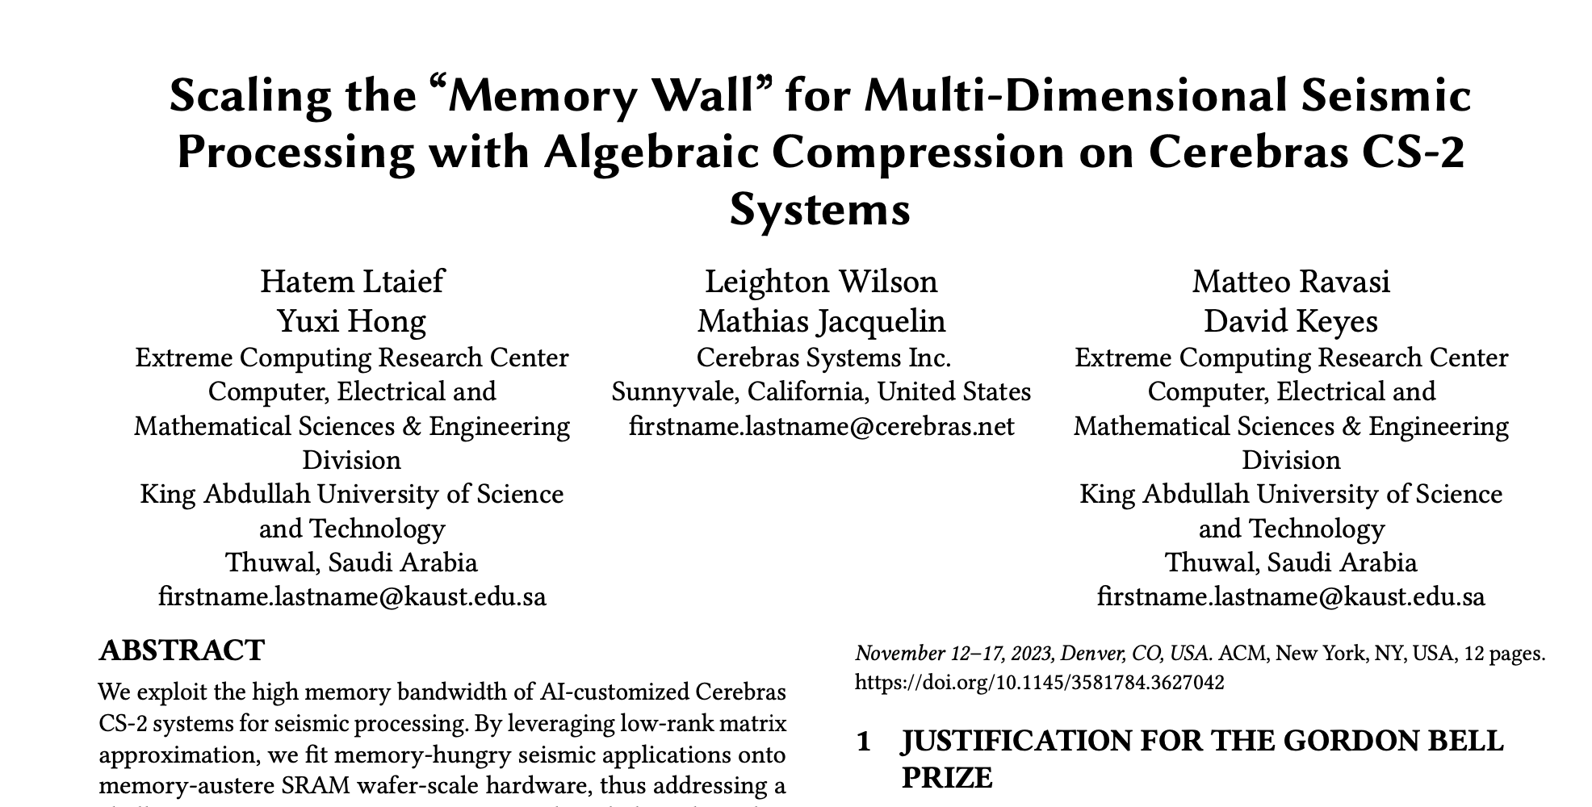
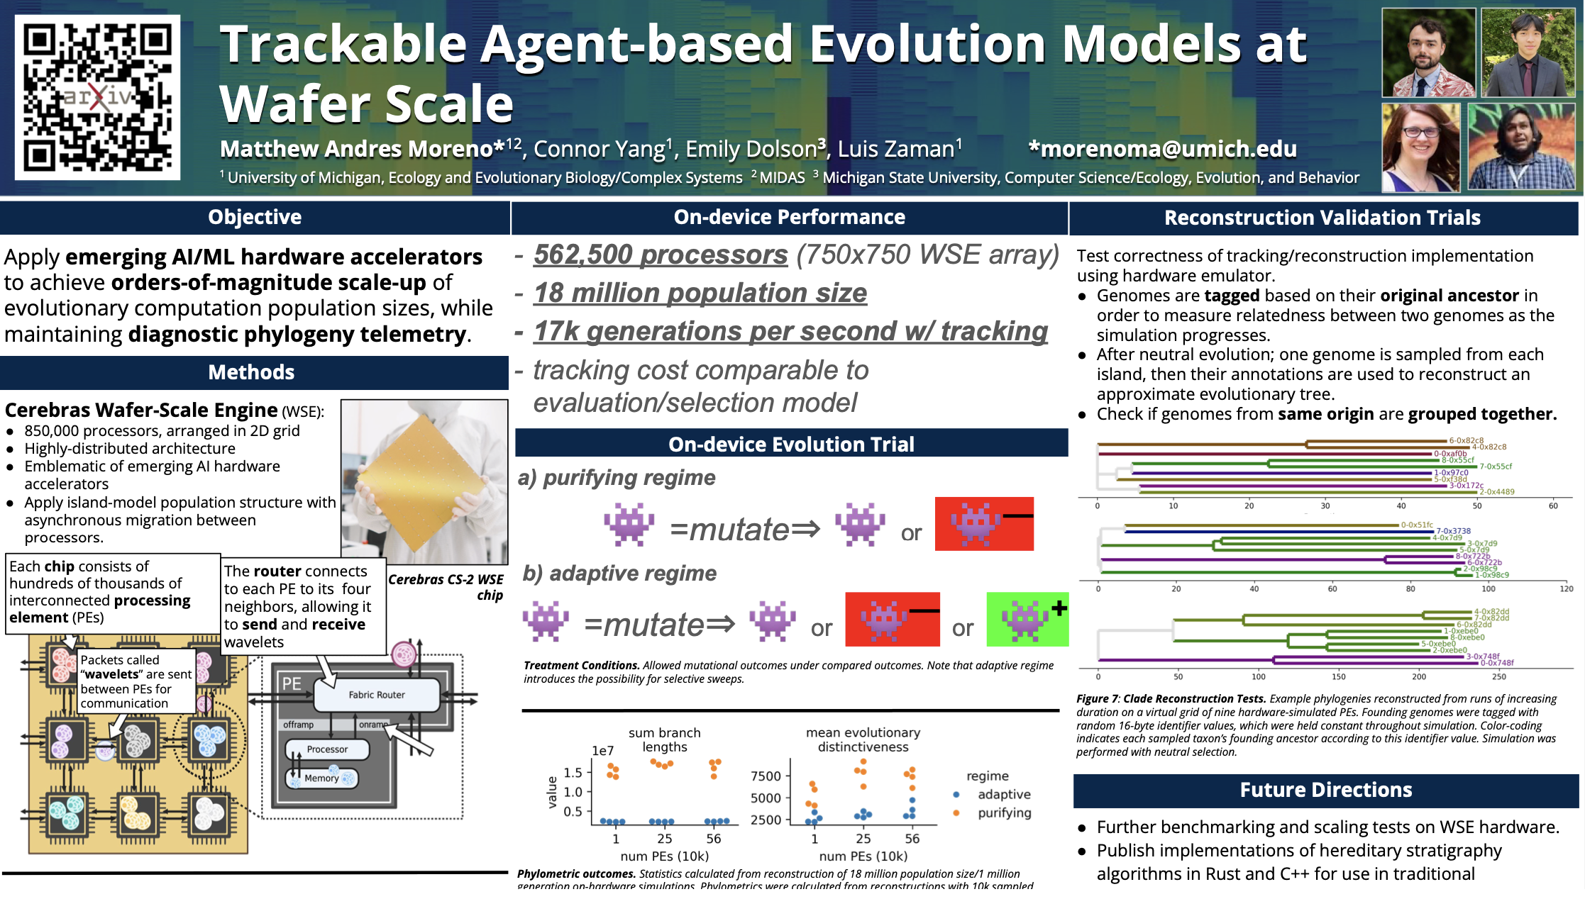
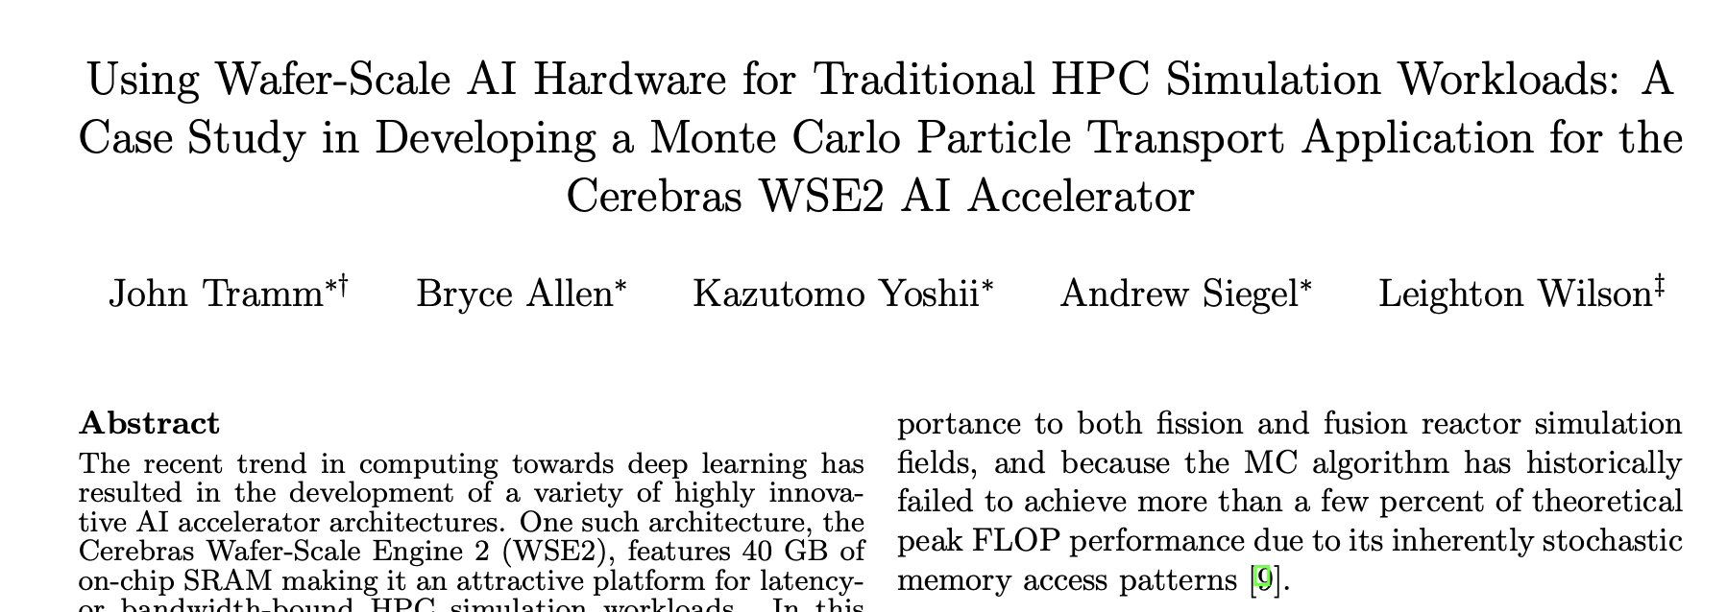
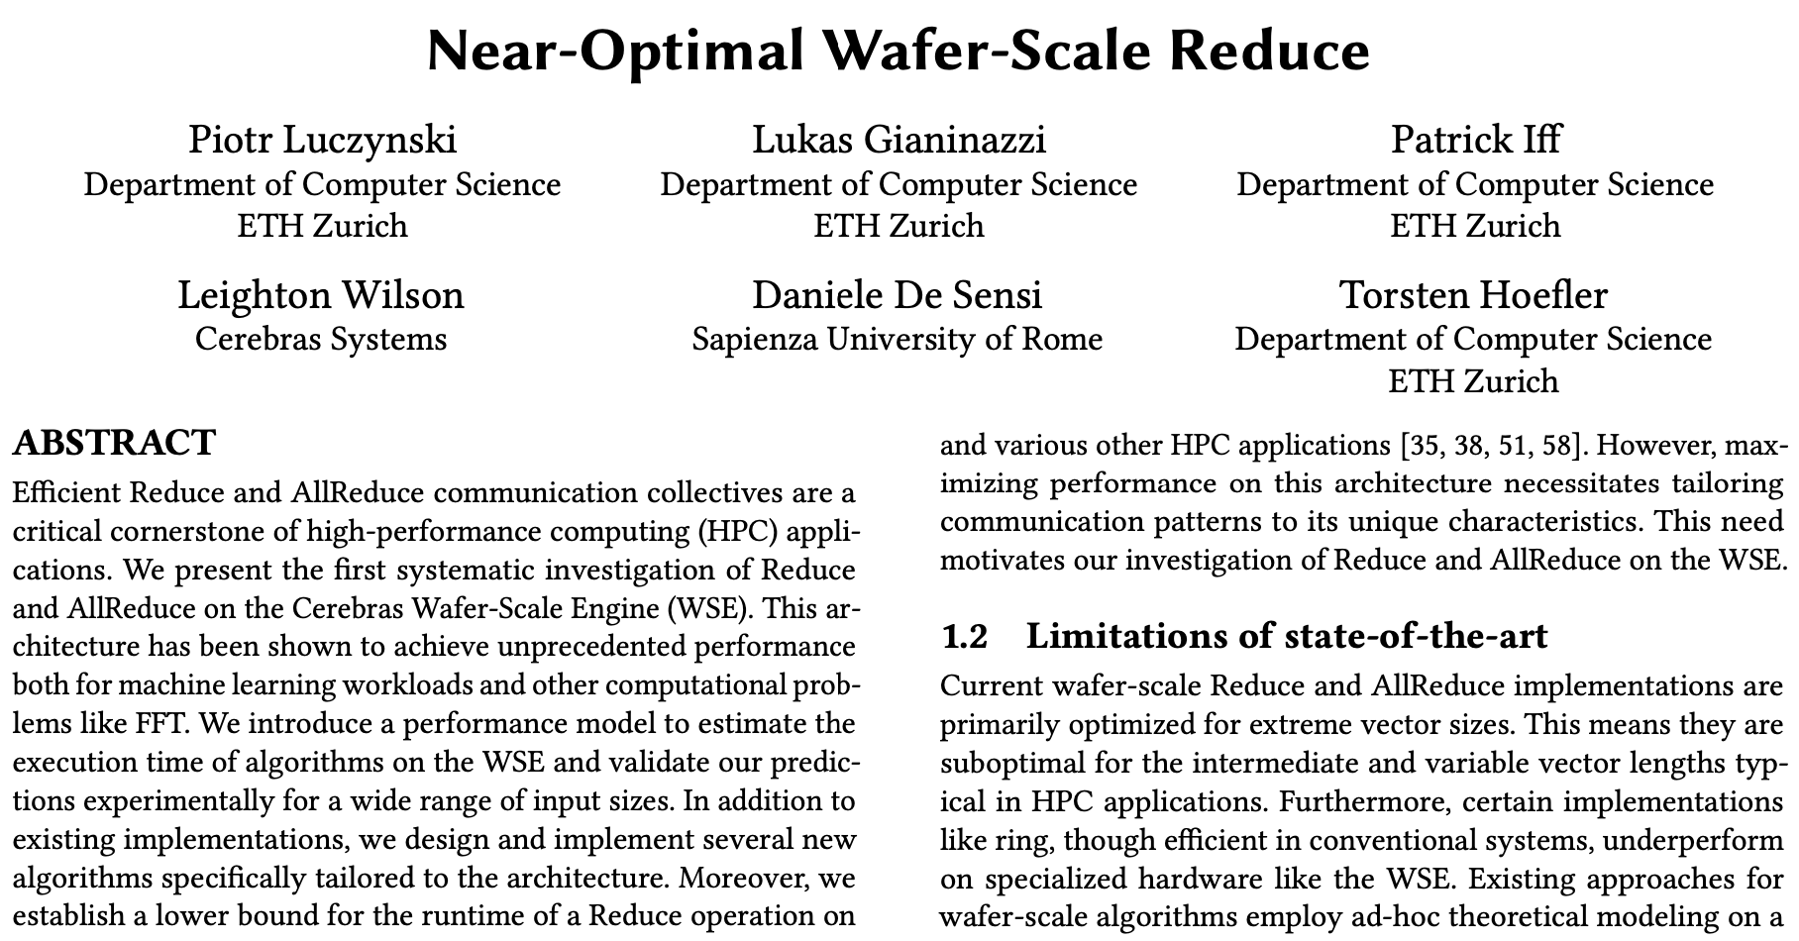
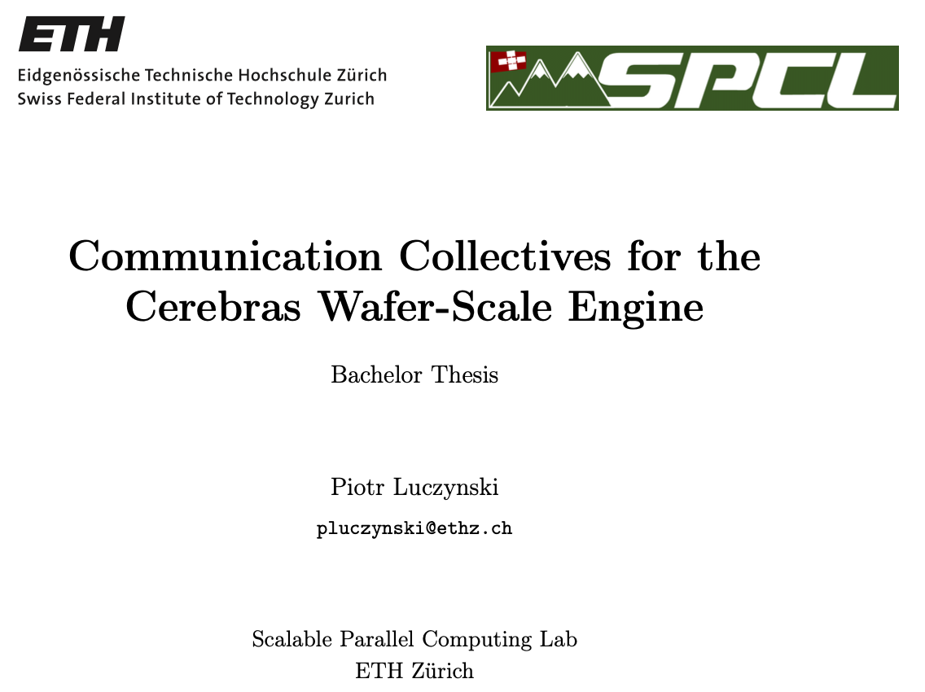

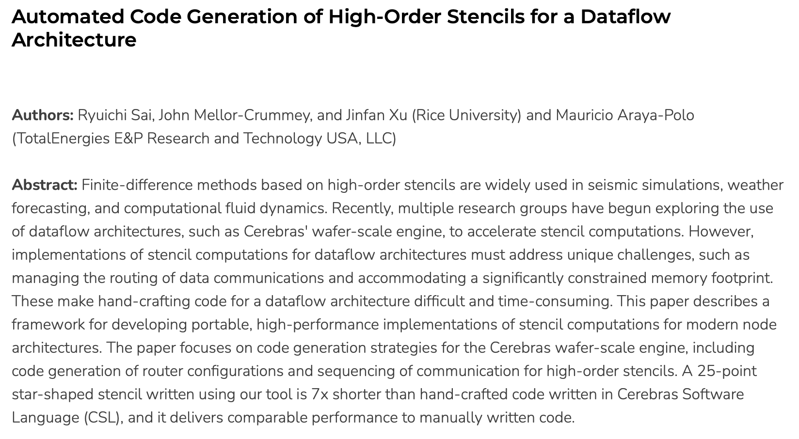
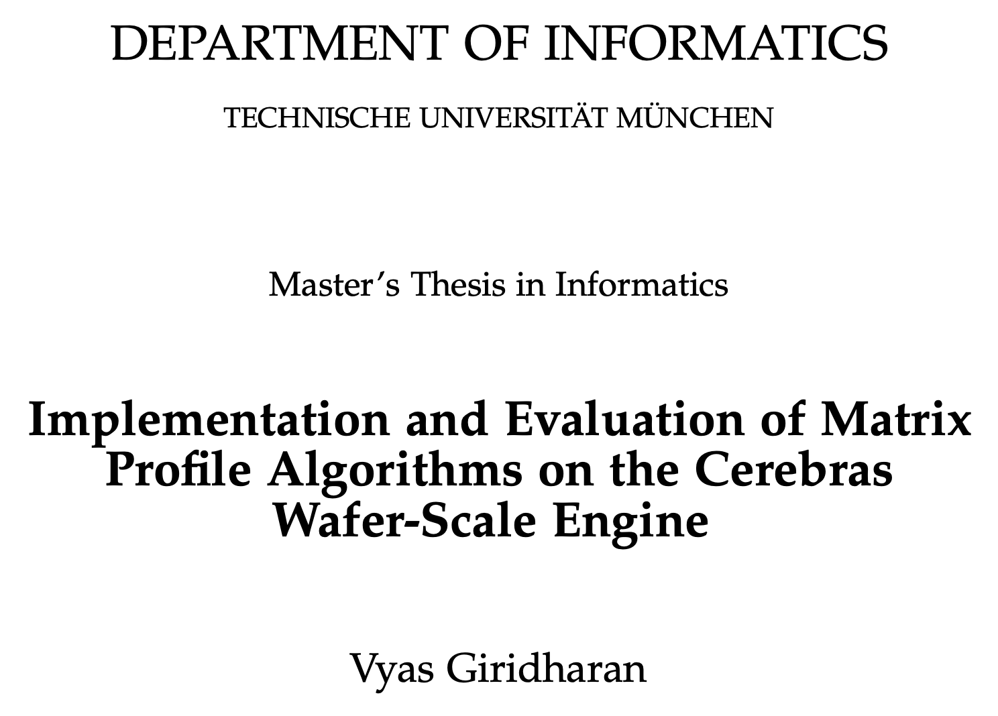
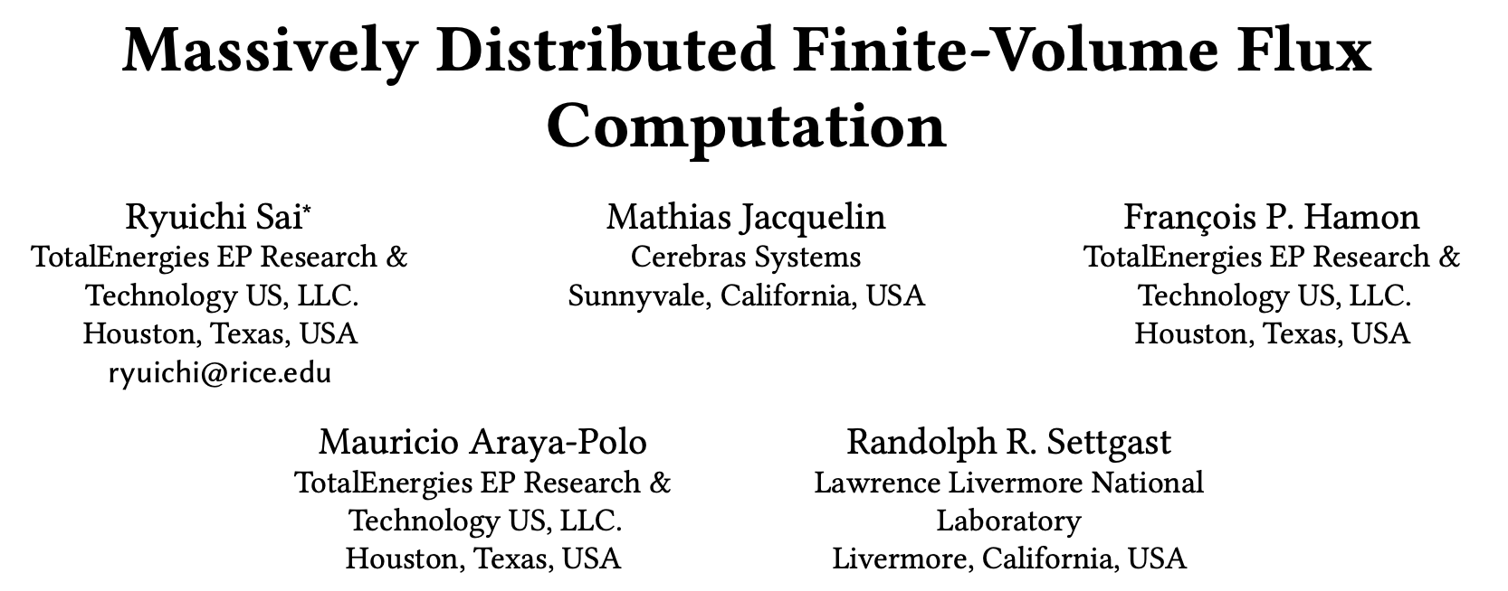
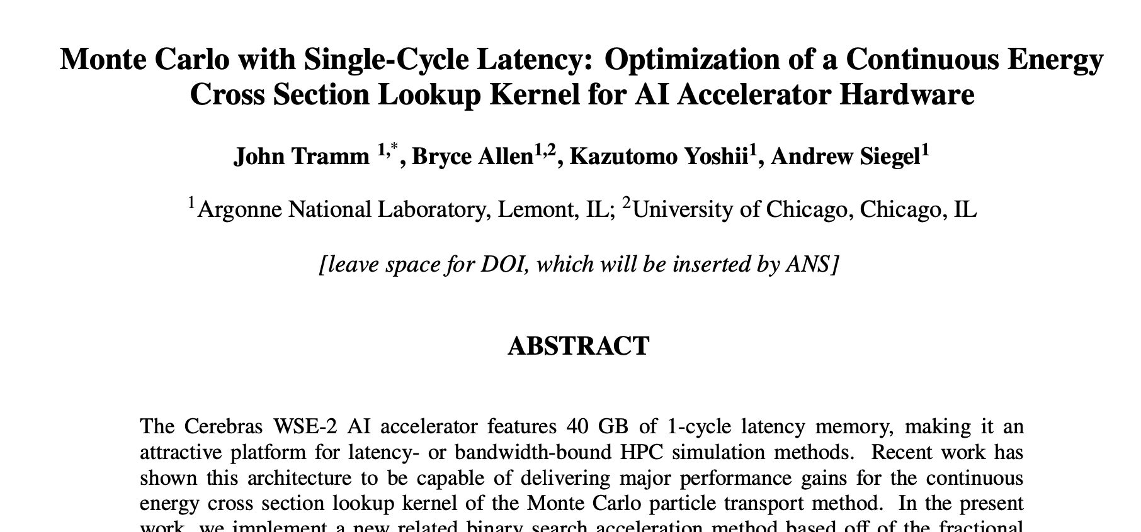
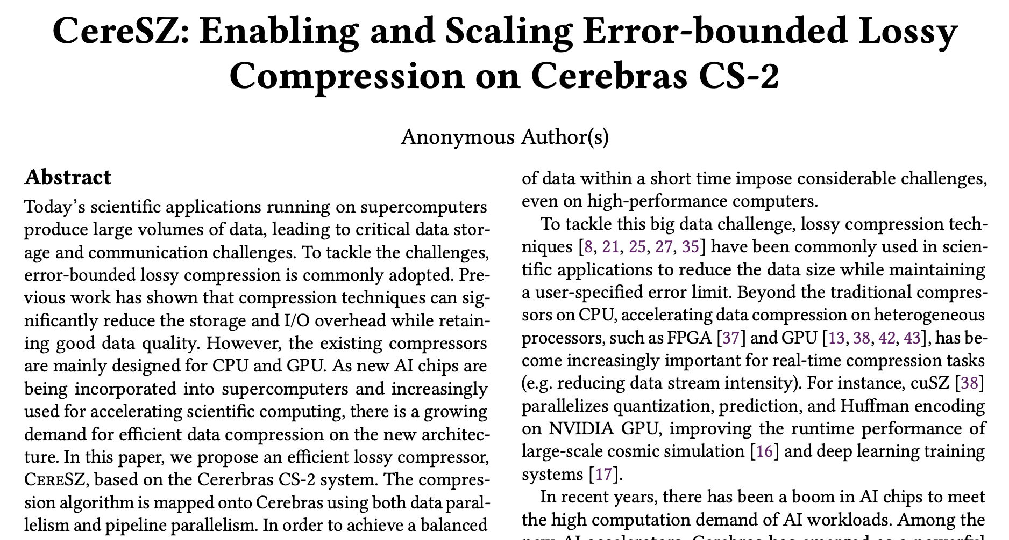
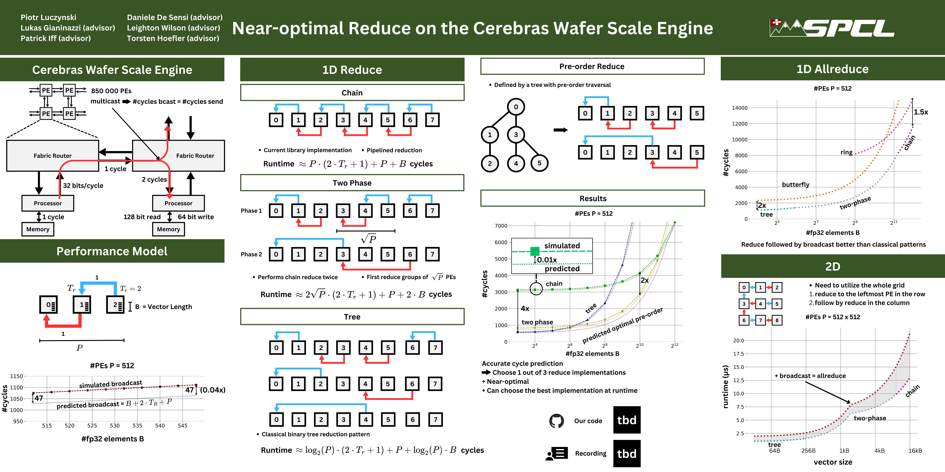

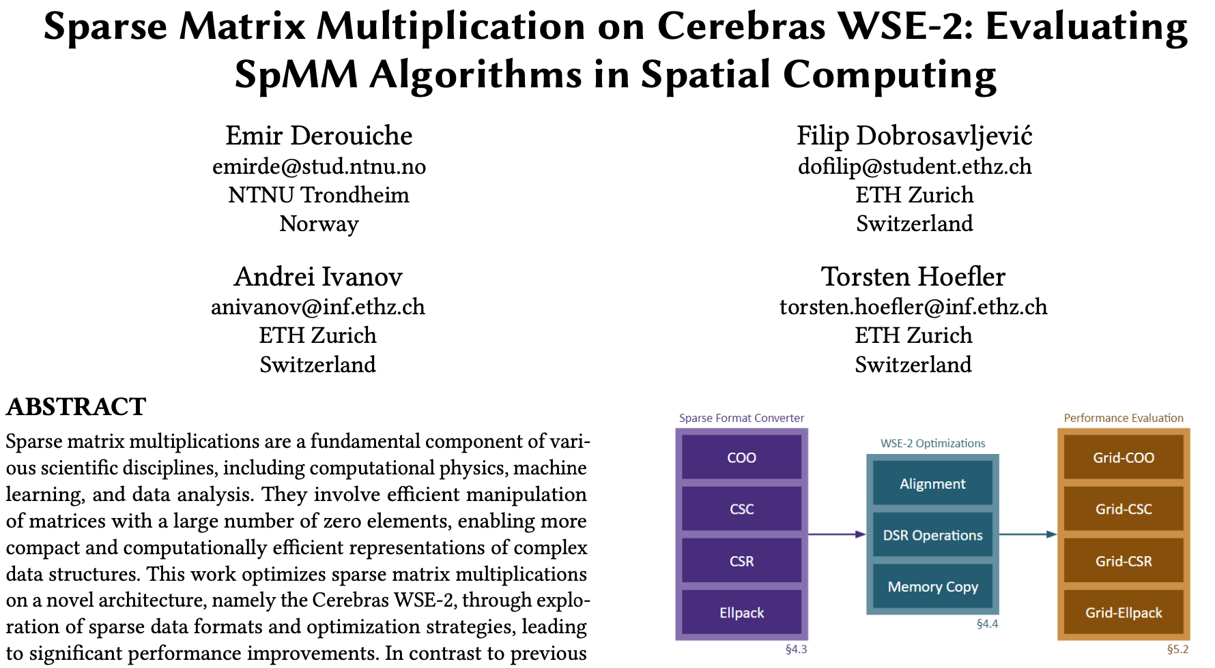
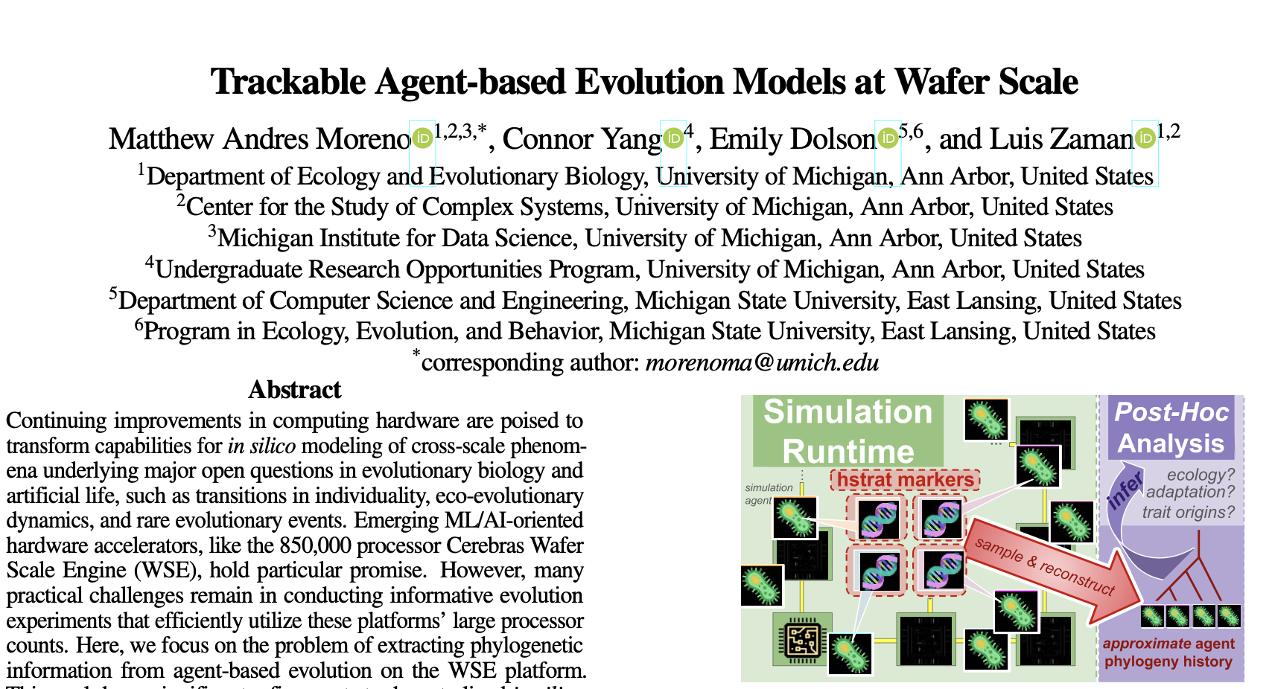
SDK Usage and Impact
The SDK has become a public platform for Wafer-Scale Computing supporting more research and publications than ever.

Slide 22
SDK Usage and Impact
The SDK has become a public platform for Wafer-Scale Computing supporting more research and publications than ever.

Slide 23
TotalEnergies achieves 228x speedup vs. A100 on seismic imaging algorithm
Common computational approaches to solving seismic imaging problems, such as stencil methods, are typically memory-bound.
Additionally, strong scaling is typically limited by fabric bandwidth between compute nodes.
Total has addressed these challenges with Cerebras:
Implemented 25-point stencil for the 3D wave equation with source perturbation, achieved 228x speedup over A100. Presented at SC22.
Implemented finite volume flux computation for single phase flow, achieved 204x speedup over A100. Presented at SC23.
Additionally developed proprietary RTM (Reverse Time Migration) code for internal use.
Compute-bound on CS-2
Roofline model for CS-2 and Nvidia A100
Memory-bound on GPU
18.5 TFLOPS
Papers: https://arxiv.org/abs/2204.03775 and https://arxiv.org/abs/2304.11274

Slide 24
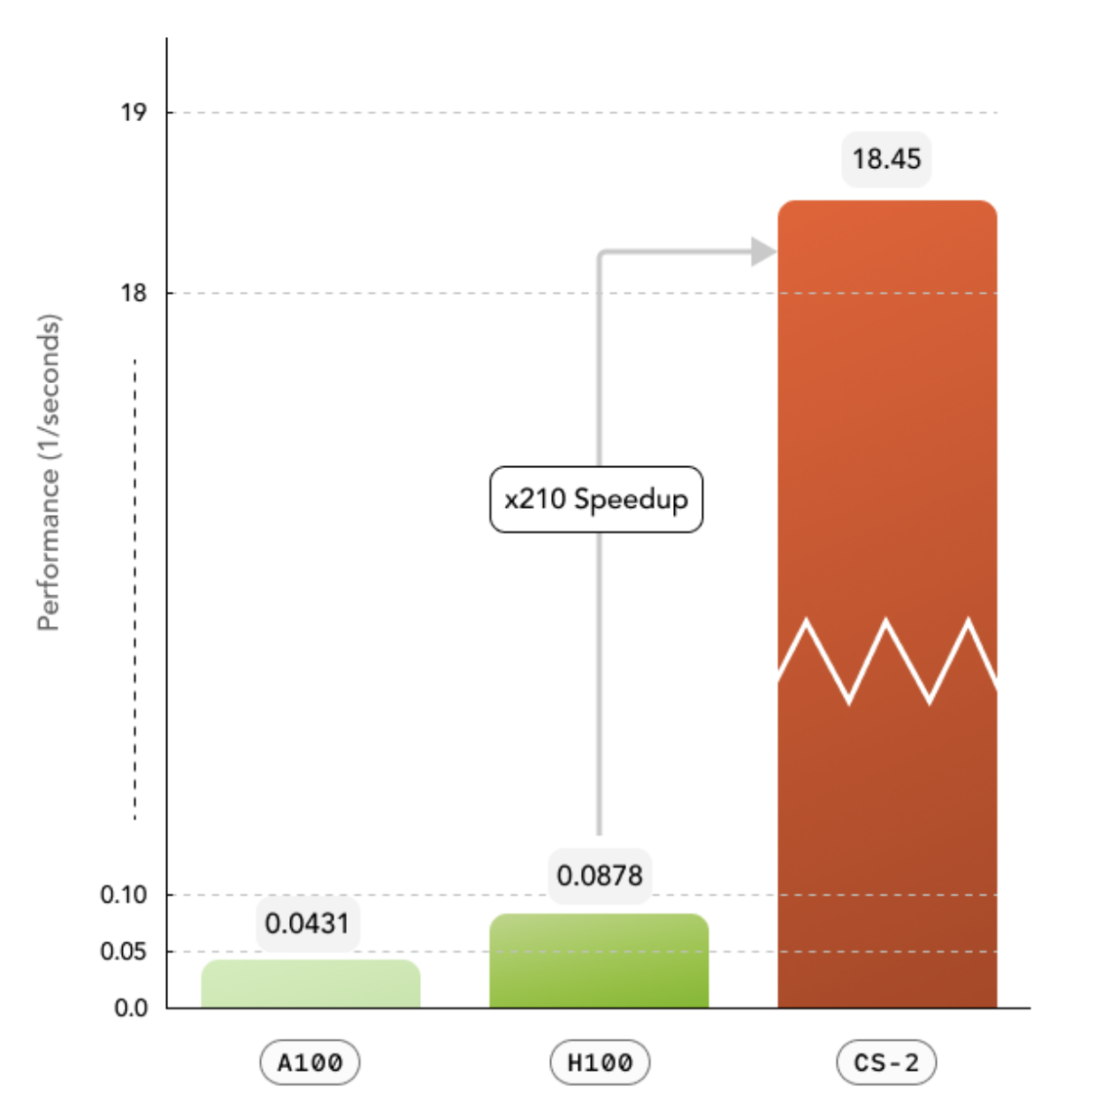
TotalEnergies achieves >200x H100 on finite volume simulation
TotalEnergies keeps innovating with Cerebras in 2024
Matrix-free finite volume solvers are an essential tool for Total’s work on geological carbon capture and storage
Solver implementation for CS-2 achieved 210x speedup over H100 GPU
Total has also developed StencilPy, a Python framework for stencil computations on the wafer-scale engine
StencilPy 25-pt stencil for seismic acoustic wave propagation achieved 95x speedup over H100 GPU
Both papers to appear at SC24
Papers: https://arxiv.org/pdf/2408.03452 and https://arxiv.org/pdf/2309.04671
Blogs: Matrix-free finite volume and StencilPy

Slide 25
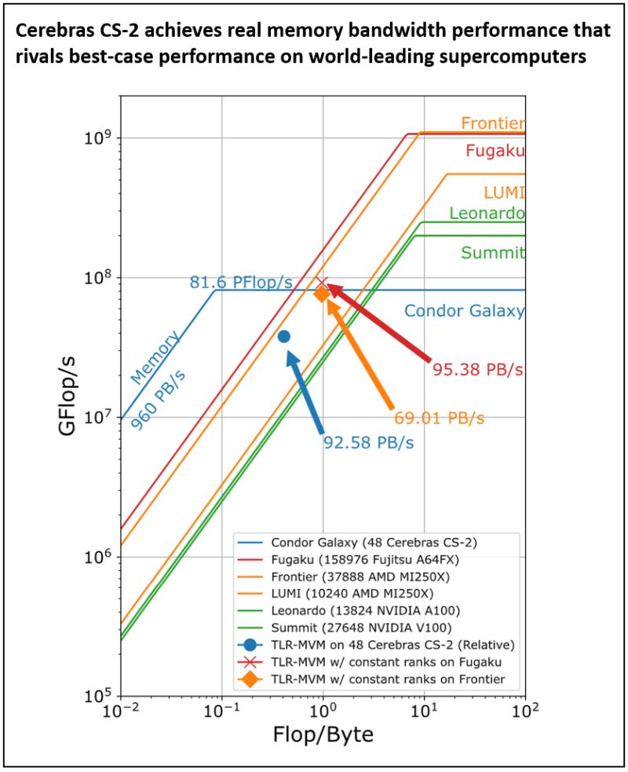

Cerebras and KAUST break records on seismic processing
Researchers redesigned a Tile Low-Rank Matrix-Vector Multiplication (TLR-MVM) algorithm for Cerebras CS-2, taking advantage of the ultra high memory bandwidth
Provided researchers with CG-1 AI supercomputer to run this simulation
Achieved sustained memory bandwidth of 92.58 PB/s across 48 CS-2 systems – higher than Frontier (#1 TOP500), comparable to Fugaku (#4 TOP500)
2023 Gordon Bell Prize finalist
Paper: https://dl.acm.org/doi/10.1145/3581784.3627042

Slide 26
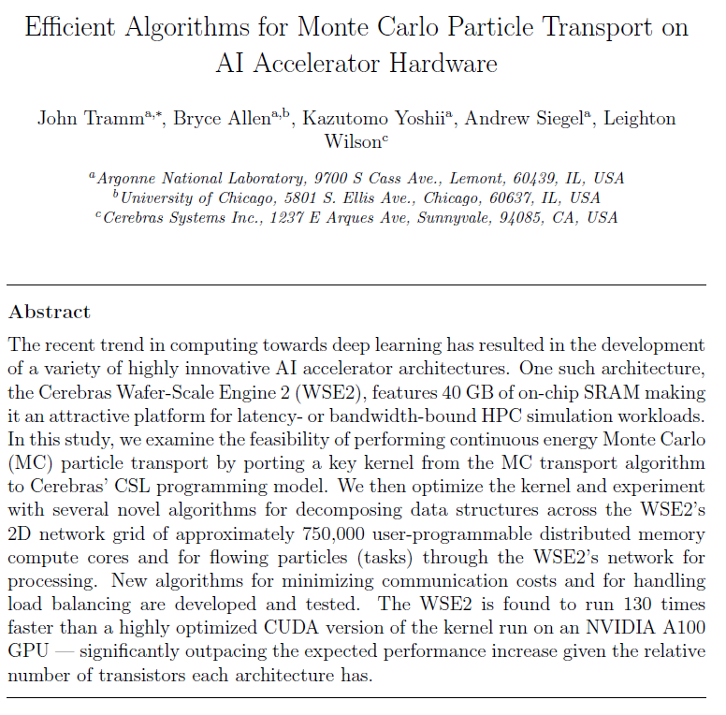
Argonne National Labs Uses CS-2 to Accelerate Monte Carto Particle Transport by 180x Over A100
“The WSE is found to run 130 times faster than a highly optimized CUDA version of the kernel run on an NVIDIA A100 GPU – significantly outpacing the expected performance increase given the relative number of transistors each architecture has”
New PHYSOR publication demonstrates 180x over A100.
Paper: https://arxiv.org/abs/2311.01739

Slide 27
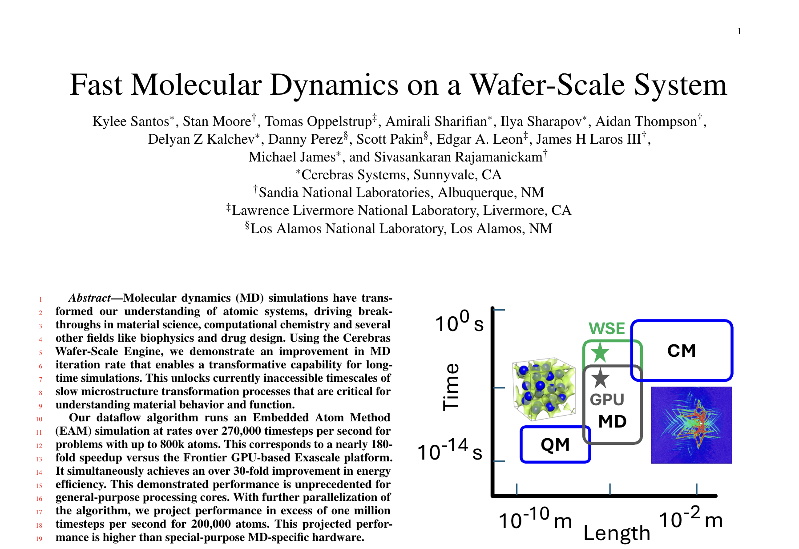
CS-2 Accelerates molecular dynamics for metallic alloys
179x faster than Frontier
“Measured performance and power efficiency of WSE, GPU, and CPU systems on 800,000-atom simulations. WSE used FP32 precision while GPU and CPU used FP64 precision. (a) A single WSE wafer results in 179x and 55x speedup compared to Frontier and CPU based simulations; (b) WSE provides one to two orders of magnitude improvement in power efficiency over both CPU and GPU systems; (c) Relative power efficiency and speedup of WSE compared to CPU and GPU systems.”
2024 Gordon Bell Prize finalist

Slide 28
Running on Neocortex
Notes:
About our system.

Slide 29
Compiling and Running on Neocortex
Three ways to run:
Run in the simulator from the command line
Submit a SLURM job for simulator runs
Submit a SLURM job for hardware runs
# Compile command
cslc ./layout.csl --fabric-dims=11,6 --fabric-offsets=4,1 \
--memcpy --channels=1 -o out
# Run command
cs_python run.py --name out

Slide 30
Bonus Example Walkthrough:
Distributed GEMV
See: gemv-08-routes-3
gemv-09-streaming
Notes:
About our system.

Slide 31
Example: Distributed GEMV
Run a program with non-trivial communication that performs general matrix-vector multiplication
Goals:
Highlight (1) layout, (2) PE programming, and (3) runtime components of a non-trivial program
Write a CSL program with multiple tasks and communication between PEs
Use memory, fabric input, and fabric output DSDs
Use the checkerboard pattern for communicating data across wafer
Use the memcpy framework to move data on and off wafer
Location of example:
https://sdk.cerebras.net/csl/code-examples/tutorial-gemv-09-streaming

Slide 32
GEMV
A
x
b
y
16
1
1
1
16
32
×
+
32
=
32

Slide 33
GEMV
A
x
b
y
16
1
1
1
16
32
×
+
32
=
32
Problem is distributed onto 4 x 4 grid of PEs.

Slide 34
GEMV
x
x
b
A
y
16
(0,0)
(1,0)
(2,0)
(3,0)
×
+
(0,1)
(1,1)
(2,1)
(3,1)
(0,2)
(1,2)
(2,2)
(3,2)
(0,3)
(1,3)
(2,3)
(3,3)
Host streams in b from the West, x from the North; streams out y to the East
A is copied to the wafer

Slide 35



GEMV Problem Steps
Device
Host

Slide 36
1. Host copies A to PEs
Device
Host

Slide 37
x₀
x₄
x₈
x₁₂
2. Host streams in 0th, 4th, 8th, 12th elements of x into PEs (0,0), (1,0), (2,0), (3,0), respectively
Device
Host

Slide 38
3. Activated task forward elements to PEs (0,i), (1,i), (2,i), (3,i)
Device
x₀
x₄
x₈
x₁₂
Host

Slide 39
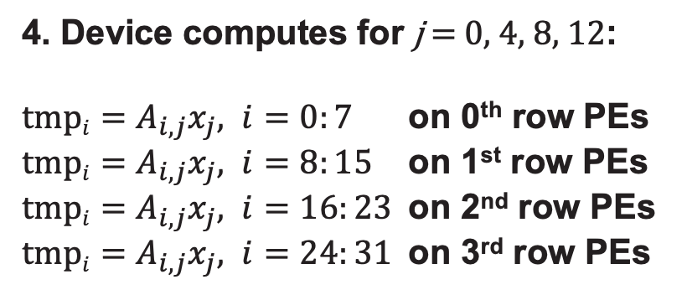
Device
4. Device computes for j = 0, 4, 8, 12:
$tmpi=A_{i,j}x_{j}, i=0:7$ on 0th row PEs
$tmpi=A_{i,j}x_{j}, i=8:15$ on 1st row PEs
$tmpi=A_{i,j}x_{j}, i=16:23$ on 2nd row PEs
$tmpi=A_{i,j}x_{j}, i=24:31$ on 3rd row PEs
...
...
...
...
...
...
...
...
Host
...
...
...
...
...
...
...
...

Slide 40
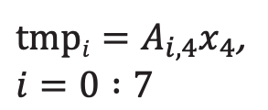
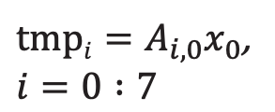
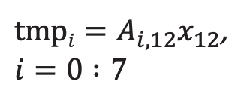
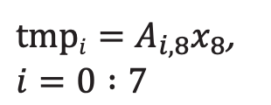
$tmpi=A_{i,0}x_{0}$,
$$i=0 :7$$
$tmpi=A_{i,4}x_{4}$,
$$i=0 :7$$
$tmpi=A_{i,8}x_{8}$,
$$i=0 :7$$
$tmpi=A_{i,12}x_{12}$,
$$i=0 :7$$
*
*
*
*
PE (0,0)
PE (1,0)
PE (2,0)
PE (3,0)

Slide 41
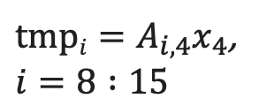
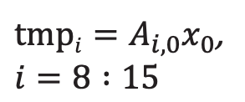
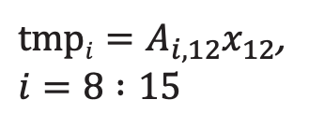
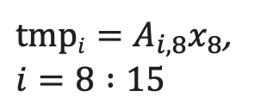
$tmpi=A_{i,0}x_{0}$,
$$i=8 :15$$
$tmpi=A_{i,4}x_{4}$,
$$i=8 :15$$
$tmpi=A_{i,8}x_{8}$,
$$i=8 :15$$
$tmpi=A_{i,12}x_{12}$,
$$i=8 :15$$
*
*
*
*
PE (0,1)
PE (1,1)
PE (2,1)
PE (3,1)

Slide 42
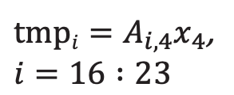

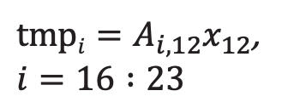
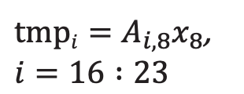
$tmpi=A_{i,0}x_{0}$,
$$i=16 :23$$
$tmpi=A_{i,4}x_{4}$,
$$i=16 :23$$
$tmpi=A_{i,8}x_{8}$,
$$i=16 :23$$
$tmpi=A_{i,12}x_{12}$,
$$i=16 :23$$
*
*
*
*
PE (0,2)
PE (1,2)
PE (2,2)
PE (3,2)

Slide 43




$tmpi=A_{i,0}x_{0}$,
$$i=24 :31$$
$tmpi=A_{i,4}x_{4}$,
$$i=24 :31$$
$tmpi=A_{i,8}x_{8}$,
$$i=24 :31$$
$tmpi=A_{i,12}x_{12}$,
$$i=24 :31$$
*
*
*
*
PE (0,3)
PE (1,3)
PE (2,3)
PE (3,3)

Slide 44
x₁
x₅
x₉
x₁₃
5. Host streams in 1st, 5th, 9th, 13th elements of x into PEs (0,0), (1,0), (2,0), (3,0), respectively
Device
Host

Slide 45
6. Activated task forward elements to PEs (0,i), (1,i), (2,i), (3,i)
Device
x₁
x₅
x₉
x₁₃
Host

Slide 46

Device
7. Device computes for j = 1, 5, 9, 13:
$tmpi=A_{i,j}x_{j}, i=0:7$ on 0th row PEs
$tmpi=A_{i,j}x_{j}, i=8:15$ on 1st row PEs
$tmpi=A_{i,j}x_{j}, i=16:23$ on 2nd row PEs
$tmpi=A_{i,j}x_{j}, i=24:31$ on 3rd row PEs
...
...
...
...
...
...
...
...
Host
...
...
...
...
...
...
...
...

Slide 47




$tmpi+=A_{i,1}x_{1}$,
$$i=0 :7$$
$tmpi+=A_{i,5}x_{5}$,
$$i=0 :7$$
$tmpi+=A_{i,9}x_{9}$,
$$i=0 :7$$
$tmpi+=A_{i,13}x_{13}$,
$$i=0 :7$$
*
*
*
*
+
+
+
+
PE (0,0)
PE (1,0)
PE (2,0)
PE (3,0)

Slide 48




$tmpi+=A_{i,1}x_{1}$,
$$i=8 :15$$
$tmpi+=A_{i,5}x_{5}$,
$$i=8 :15$$
$tmpi+=A_{i,9}x_{9}$,
$$i=8 :15$$
$tmpi+=A_{i,13}x_{13}$,
$$i=8 :15$$
*
*
*
*
+
+
+
+
PE (0,1)
PE (1,1)
PE (2,1)
PE (3,1)

Slide 49




$tmpi+=A_{i,1}x_{1}$,
$$i=16 :23$$
$tmpi+=A_{i,5}x_{5}$,
$$i=16 :23$$
$tmpi+=A_{i,9}x_{9}$,
$$i=16 :23$$
$tmpi+=A_{i,13}x_{13}$,
$$i=16 :23$$
*
*
*
*
+
+
+
+
PE (0,2)
PE (1,2)
PE (2,2)
PE (3,2)

Slide 50




$tmpi+=A_{i,1}x_{1}$,
$$i=24 :31$$
$tmpi+=A_{i,5}x_{5}$,
$$i=24 :31$$
$tmpi+=A_{i,9}x_{9}$,
$$i=24 :31$$
$tmpi+=A_{i,13}x_{13}$,
$$i=24 :31$$
*
*
*
*
+
+
+
+
PE (0,3)
PE (1,3)
PE (2,3)
PE (3,3)

Slide 51
x₂
x₆
x₁₀
x₁₄
8. Host streams in x₂, x₆, x₁₀, x₁₄
9. Task forwards elements South
10. Device computes contributions to tmp
Device
x₂
x₆
x₁₀
x₁₄
Host

Slide 52
x₃
x₇
x₁₁
x₁₅
11. Host streams in x₃, x₇, x₁₁, x₁₅
12. Task forwards elements South
13. Device computes contributions to tmp
Device
x₃
x₇
x₁₁
x₁₅
Host

Slide 53
14. Host streams in elements of b in equal chunks to PEs (0,0), (0,1), (0,2), (0,3), respectively
Device
b_{0:7}
b_{8:15}
b_{16:23}
Host
b_{24:31}

Slide 54
15. Send values along RAMP → RAMP routing to be received from fabric in compute task
Device
Host

Slide 55

Device
16. When $Ax$ chunk and b values are available, PEs along left edge calculate contribution of b to tmp
...
...
Host
...
...

Slide 56




$tmpi+=bi$,
$$i=0 :7$$
$tmpi+=bi$,
$$i=8 :15$$
$tmpi+=bi$,
$$i=16 :23$$
$tmpi+=bi$,
$$i=24 :31$$
+
+
+
+
PE (0,0)
PE (0,1)
PE (0,2)
PE (0,3)

Slide 57
17. PEs along left edge send their running sum tmp to the East
Device
Host

Slide 58
18. PEs in column 1 accumulate contribution to tmp sent by PEs from column 0
Device
...
...
Host
...
...

Slide 59





Let $ui$ be values sent in from West.
$tmpi+=ui$,
$$i=0 :7$$
$tmpi+=ui$,
$$i=8 :15$$
$tmpi+=ui$,
$$i=16 :23$$
$tmpi+=ui$,
$$i=24 :31$$
+
+
+
+
PE (1,0)
PE (1,1)
PE (1,2)
PE (1,3)

Slide 60
19. PEs in column 1 send their running sum tmp to the East
Device
Host

Slide 61
20. PEs in column 2 accumulate contribution to tmp sent by PEs from column 1
Device
...
...
Host
...
...

Slide 62
Let $ui$ be values sent in from West.
$tmpi+=ui$,
$$i=0 :7$$
$tmpi+=ui$,
$$i=8 :15$$
$tmpi+=ui$,
$$i=16 :23$$
$tmpi+=ui$,
$$i=24 :31$$
+
+
+
+
PE (2,0)
PE (2,1)
PE (2,2)
PE (2,3)

Slide 63
21. PEs in column 2 send their running sum tmp to the East
Device
Host

Slide 64
22. PEs in column 3 accumulate contribution to tmp sent by PEs from column 2
Device
...
...
Host
...
...

Slide 65





Let $ui$ be values sent in from West.
$yi$is in same memory location as $tmpi$.
$yi=tmpi+ui$,
$$i=0 :7$$
$yi=tmpi+ui$,
$$i=8 :15$$
$yi=tmpi+ui$,
$$i=16 :23$$
$yi=tmpi+ui$,
$$i=24 :31$$
+
+
+
+
PE (3,0)
PE (3,1)
PE (3,2)
PE (3,3)

Slide 66
23. PEs along right edge send final sum y to the East
Device
Host

Slide 67
24. Host receives y from fabric
Device
Host

Slide 68
GEMV Color Routes
Device
Host

Slide 69

GEMV Color Routes
Circle: RAMP
Outline: rx
Solid: tx

Slide 70
GEMV Color Routes
I/O
memcpy infra
I/O
I/O
I/O
memcpy infra
program
memcpy infra
I/O
I/O
memcpy infra

Slide 71
GEMV Color Routes
Color 5:
On row 0, receive from Ramp
On rows 1, 2, 3, receive from North
On rows 0, 1, 2, transmit down Ramp and South
On row 3, transmit down Ramp
Device
Host

Slide 72

GEMV Color Routes
Circle: RAMP
Outline: rx
Solid: tx

Slide 73
GEMV Color Routes–CSL Layout
// Set routes for color blue, used for communicating x
for (@range(i16, kernel_x_dim)) |i| { // Loop over all four columns
for (@range(i16, kernel_y_dim)) |j| { // Loop over all four rows
// Handle first row
if (j == 0) {
@set_color_config(i, j, blue, .{.rx=.{RAMP}, .tx=.{RAMP, SOUTH}});
// Handle last row
} else if (j == kernel_y_dim-1) {
@set_color_config(i, j, blue, .{.rx=.{NORTH}, .tx=.{RAMP}});
} else {
@set_color_config(i, j, blue, .{.rx=.{NORTH}, .tx=.{RAMP, SOUTH}});
}
}
}

Slide 74
GEMV Color Routes
Note that we use one color for sending values of x down fabric
However, we can’t do this for sending accumulated values across fabric
Why?
  PEs are also sending values to ramp, not just receiving from ramp
  We must be able to differentiate values being sent up and down ramp
  We need at least two colors, in a checkerboard pattern

Slide 75
GEMV Color Routes
Color 3:
On column 0 and 2, receive from Ramp and transmit East
On column 1 and 3, receive from East and transmit down Ramp
Device
Host

Slide 76
GEMV Color Routes
Color 4:
On column 2, receive from West and transmit down Ramp
On column 1, receive from Ramp and transmit East
Device
Host

Slide 77

GEMV Color Routes
Circle: RAMP
Outline: rx
Solid: tx

Slide 78
GEMV Color Routes–Simplified CSL Layout
Each PE has an “out color” and an “in color”
“out color” is the routing color associated with transmitting accumulated sum
  For the last column, this is the final result y
“in color” is the routing color associated with receiving accumulated sum
  For the first column, this is the input vector b
*italicized colors are memcpy colors
 | Column 0 | Column 1 | Column 2 | Column 3
in color | red* → yellow | green | yellow | green
out color | green | yellow | green | magenta*

Slide 79
GEMV Color Routes–CSL Layout
for (@range(i16, kernel_x_dim)) |i| { // Loop over all four columns
for (@range(i16, kernel_y_dim)) |j| { // Loop over all four rows
if (i == 0) { // Handle first column
@set_color_config(i, j, yellow, .{.rx=.{RAMP}, .tx=.{RAMP}});
@set_color_config(i, j, green, .{.rx=.{RAMP}, .tx=.{EAST}});
} else if (i % 2) { // Handle even columns
@set_color_config(i, j, yellow, .{.rx=.{WEST}, .tx=.{RAMP}});
@set_color_config(i, j, green, .{.rx=.{RAMP}, .tx=.{EAST}});
} else { // Handle odd columns
@set_color_config(i, j, yellow, .{.rx=.{RAMP}, .tx=.{EAST}});
@set_color_config(i, j, green, .{.rx=.{WEST}, .tx=.{RAMP}});
}
}
}
*yellow is unused on last column

Slide 80
GEMV Color Routes
Memcpy colors 0, 1, 2:
Used to stream data into and out of our program area
Memcpy handles the routing
Memcpy module uses 21, 22, 23
Device
Host

Slide 81

Memcpy User Color Routes
Circle: RAMP
Outline: rx
Solid: tx
Color 0
Color 1
Color 2

Slide 82

Memcpy Module Routes
Circle: RAMP
Outline: rx
Solid: tx
Color 21
Color 22
Color 23
Routes shown are only in program rectangle.

Slide 83
GEMV: Writing the CSL
We create a file named pe_program.csl that defines our program
What do we need to do in our device code?
Define color parameters
Define global variables for each PE
Define DSDs for our PE
Define task that activates for multiplying elements of A by x
Define task that accumulates sum
Define initial state of our task and colors, bind tasks to a color
Define layout of program and set parameters
Define routes for each color

Slide 84
What resources are available?
Routable Colors
Input Queues
Output Queues
24 colors available
Labeled by IDs 0–23
memcpy uses 21–23
8 IQs available
Associated w/ color
memcpy uses IQ 0, 1
8 OQs available
Associated w/ color
memcpy uses OQ 0
Tasks
Microthreads
Data Structure Registers
8 data tasks (IDs 0–7)
  Bound to IQs
23 local tasks (IDs 8–30)
12 microthreads
Used for ops w/ fabric
memcpy uses UT 0
48 DSRs
CSL handles allocation
memcpy uses 2

Slide 85
A Word on Tasks
In this example, we have data tasks and local tasks
Whenever a task finishes, a task picker chooses a task from eligible tasks in the task table
A task is eligible if it activated and unblocked
Data tasks are activated by the receipt of wavelets from the fabric
Local tasks are activated by explicit command from the programmer
var result: f32 = 0.0;
var sum: f32 = 0.0;
task foo_task(wavelet_data: f32) {
result = wavelet_data;
@activate(foo_task_id);
}
task bar_task() {
sum += result;
}
Activated by receipt of wavelet in queue to which foo_task is bound
Activated by @activate call in foo_task

Slide 86
A Word on Tasks
var result: f32 = 0.0;
var sum: f32 = 0.0;
task main_task(wavelet_data: f32) {
result = wavelet_data;
@activate(foo_task_id);
@activate(bar_task_id);
}
task foo_task() {
sum += result;
@unblock(bar_task_id);
}
task bar_task() {
sum *= 2.0;
}
comptime { @block(bar_task_id); }
Activate both foo_task and bar_task, but only foo_task is eligible, as bar_task is blocked
Unblock bar_task when foo_task runs, so bar_task runs next
Block bar_task at compile time

Slide 87
A Word on Queues and Microthreads
IQs and OQs serve as “buffers” for sending and receiving wavelets to and from fabric
In addition to data tasks, IQs are also used when an operation has an input fabric operand
OQs are used when an operation has an output fabric operand
Operations with fabric operands can execute on asynchronous microthreads
By default, microthread ID is taken from ID of queue used in operation
IQs and OQs are bound to colors (but can be re-bound to different color at runtime)
task foo_task() void {
const in_dsd = @get_dsd(fabin_dsd, .{
.fabric_color = recv, .extent = 2, .input_queue = recv_iq });
const out_dsd = @get_dsd(fabout_dsd, .{
.fabric_color = send, .extent = 2, .output_queue = send_oq });
@fadds(out_dsd, in_dsd, 5.0, .{ .async = true, .activate = bar_task });
}

Slide 88
Colors
Color ID | Name | Purpose
0 | MEMCPYH2D_DATA_1_ID | Receive x from host
1 | MEMCPYH2D_DATA_2_ID | Receive b from host
2 | MEMCPYD2H_DATA_1_ID | Send y to host
3 | Even columns: send_east_color Odd columns: recv_west_color | Even columns: Transmit psum Odd columns: Receive psum
4 | Even columns: recv_west_color Odd columns: send_east_color | Even columns: Receive psum Odd columns: Transmit psum
5 | x_color | Top row: Transmit x elems All rows: Receive x elems
…
…

Slide 89
Tasks
Task ID | Name | IQ ID | IQ Name | Color ID | Color Name | Purpose
0 | (reserved)
1 | (reserved)
2 | memcpy_recv_x | 2 | h2d_x_iq | 0 | MEMCPYH2D_DATA_1_ID | On top row, receive x from fabric and forward along x_color
3 | memcpy_recv_b | 3 | h2d_b_iq | 1 | MEMCPYH2D_DATA_2_ID | On left column, receive b from fabric and forward along send_east_color
4 | recv_x | 4 | recv_x_iq | 2 | x_color | Receive x and compute Ax chunk. Activate reduce task when all x elems processed
…
…
10 | reduce | -- | -- | -- | -- | Receive running sum from fabin DSD on recv_west_color, reduce with local chunk, send out on send_east_color. Last column sends to host.

Slide 90
Input Queues
IQ ID | Name | Color ID | Color Name | Purpose
0 | (reserved)
1 | (reserved)
2 | h2d_x_iq | 0 | MEMCPYH2D_DATA_1_ID | Bound to memcpy_recv_x task
3 | h2d_b_iq | 1 | MEMCPYH2D_DATA_2_ID | Bound to memcpy_recv_b task
4 | recv_x_iq | 5 | x_color | Bound to recv_x task
5 | recv_w_iq | Even columns: 4 Odd columns: 3 | recv_west_color | Receives running sum in fabric input DSD
6 | ..
7 | ..

Slide 91
Output Queues
IQ ID | Name | Color ID | Color Name | Purpose
0 | (reserved)
1 | …
2 | x_oq | 5 | x_color | On top row, send x to fabric
3 | recv_w_oq | Even columns: 4 Odd columns: 3 | recv_west_color | On left column, send b to fabric
4 | d2h_oq | 2 | MEMCPYD2H_DATA_1_ID | Send final result y to host
5 | send_e_oq | Even columns: 3 Odd columns: 4 | send_east_color | Send out running sum to the East
6 | …
7 | …

Slide 92
recv_x task
// 48 kB of global memory contain A, x, b, y
var A: [M_per_PE*N_per_PE]f32; // A is stored column major
var y: [M_per_PE]f32;
// DSDs for accessing A, x, y
// A_dsd accesses column of A
var A_dsd = @get_dsd(mem1d_dsd, .{ .tensor_access = |i|{M_per_PE} -> A[i] });
var y_dsd = @get_dsd(mem1d_dsd, .{ .tensor_access = |i|{M_per_PE} -> y[i] });
// Use to keep track of # of invocations of recv_x task
// when num_recv_x == N_per_PE, we are done receiving x elements
var num_recv_x: i16 = 0;
task recv_x(x_val: f32) void {
@fmacs(y_dsd, y_dsd, A_dsd, x_val);
A_dsd = @increment_dsd_offset(A_dsd, M_per_PE, f32);
num_recv_x += 1;
if (num_recv_x == N_per_PE) @activate(reduce_task_id);
}

Slide 93
recv_x task
Global arrays in PE’s memory
// 48 kB of global memory contain A, x, b, y
var A: [M_per_PE*N_per_PE]f32; // A is stored column major
var y: [M_per_PE]f32;
// DSDs for accessing A, x, y
// A_dsd accesses column of A
var A_dsd = @get_dsd(mem1d_dsd, .{ .tensor_access = |i|{M_per_PE} -> A[i] });
var y_dsd = @get_dsd(mem1d_dsd, .{ .tensor_access = |i|{M_per_PE} -> y[i] });
// Use to keep track of # of invocations of recv_x task
// when num_recv_x == N_per_PE, we are done receiving x elements
var num_recv_x: i16 = 0;
task recv_x(x_val: f32) void {
@fmacs(y_dsd, y_dsd, A_dsd, x_val);
A_dsd = @increment_dsd_offset(A_dsd, M_per_PE, f32);
num_recv_x += 1;
if (num_recv_x == N_per_PE) @activate(reduce_task_id);
}

Slide 94
recv_x task
M_per_PE is rows per PE (8)
N_per_PE is cols per PE (4)
// 48 kB of global memory contain A, x, b, y
var A: [M_per_PE*N_per_PE]f32; // A is stored column major
var y: [M_per_PE]f32;
// DSDs for accessing A, x, y
// A_dsd accesses column of A
var A_dsd = @get_dsd(mem1d_dsd, .{ .tensor_access = |i|{M_per_PE} -> A[i] });
var y_dsd = @get_dsd(mem1d_dsd, .{ .tensor_access = |i|{M_per_PE} -> y[i] });
// Use to keep track of # of invocations of recv_x task
// when num_recv_x == N_per_PE, we are done receiving x elements
var num_recv_x: i16 = 0;
task recv_x(x_val: f32) void {
@fmacs(y_dsd, y_dsd, A_dsd, x_val);
A_dsd = @increment_dsd_offset(A_dsd, M_per_PE, f32);
num_recv_x += 1;
if (num_recv_x == N_per_PE) @activate(reduce_task_id);
}

Slide 95
recv_x task
// 48 kB of global memory contain A, x, b, y
var A: [M_per_PE*N_per_PE]f32; // A is stored column major
var y: [M_per_PE]f32;
// DSDs for accessing A, x, y
// A_dsd accesses column of A
var A_dsd = @get_dsd(mem1d_dsd, .{ .tensor_access = |i|{M_per_PE} -> A[i] });
var y_dsd = @get_dsd(mem1d_dsd, .{ .tensor_access = |i|{M_per_PE} -> y[i] });
// Use to keep track of # of invocations of recv_x task
// when num_recv_x == N_per_PE, we are done receiving x elements
var num_recv_x: i16 = 0;
task recv_x(x_val: f32) void {
@fmacs(y_dsd, y_dsd, A_dsd, x_val);
A_dsd = @increment_dsd_offset(A_dsd, M_per_PE, f32);
num_recv_x += 1;
if (num_recv_x == N_per_PE) @activate(reduce_task_id);
}
accesses first M_per_PE elems of A (1st column)

Slide 96
recv_x task
// 48 kB of global memory contain A, x, b, y
var A: [M_per_PE*N_per_PE]f32; // A is stored column major
var y: [M_per_PE]f32;
// DSDs for accessing A, x, y
// A_dsd accesses column of A
var A_dsd = @get_dsd(mem1d_dsd, .{ .tensor_access = |i|{M_per_PE} -> A[i] });
var y_dsd = @get_dsd(mem1d_dsd, .{ .tensor_access = |i|{M_per_PE} -> y[i] });
// Use to keep track of # of invocations of recv_x task
// when num_recv_x == N_per_PE, we are done receiving x elements
var num_recv_x: i16 = 0;
task recv_x(x_val: f32) void {
@fmacs(y_dsd, y_dsd, A_dsd, x_val);
A_dsd = @increment_dsd_offset(A_dsd, M_per_PE, f32);
num_recv_x += 1;
if (num_recv_x == N_per_PE) @activate(reduce_task_id);
}
accesses M_per_PE elems of y, used to store tmp (running sum of A*x chunk)

Slide 97
recv_x task
// 48 kB of global memory contain A, x, b, y
var A: [M_per_PE*N_per_PE]f32; // A is stored column major
var y: [M_per_PE]f32;
// DSDs for accessing A, x, y
// A_dsd accesses column of A
var A_dsd = @get_dsd(mem1d_dsd, .{ .tensor_access = |i|{M_per_PE} -> A[i] });
var y_dsd = @get_dsd(mem1d_dsd, .{ .tensor_access = |i|{M_per_PE} -> y[i] });
// Use to keep track of # of invocations of recv_x task
// when num_recv_x == N_per_PE, we are done receiving x elements
var num_recv_x: i16 = 0;
task recv_x(x_val: f32) void {
@fmacs(y_dsd, y_dsd, A_dsd, x_val);
A_dsd = @increment_dsd_offset(A_dsd, M_per_PE, f32);
num_recv_x += 1;
if (num_recv_x == N_per_PE) @activate(reduce_task_id);
}
Global var to keep track of # x elems processed

Slide 98
recv_x task
// 48 kB of global memory contain A, x, b, y
var A: [M_per_PE*N_per_PE]f32; // A is stored column major
var y: [M_per_PE]f32;
// DSDs for accessing A, x, y
// A_dsd accesses column of A
var A_dsd = @get_dsd(mem1d_dsd, .{ .tensor_access = |i|{M_per_PE} -> A[i] });
var y_dsd = @get_dsd(mem1d_dsd, .{ .tensor_access = |i|{M_per_PE} -> y[i] });
// Use to keep track of # of invocations of recv_x task
// when num_recv_x == N_per_PE, we are done receiving x elements
var num_recv_x: i16 = 0;
task recv_x(x_val: f32) void {
@fmacs(y_dsd, y_dsd, A_dsd, x_val);
A_dsd = @increment_dsd_offset(A_dsd, M_per_PE, f32);
num_recv_x += 1;
if (num_recv_x == N_per_PE) @activate(reduce_task_id);
}
Task calculates x elem contribution to A*x

Slide 99
recv_x task
// 48 kB of global memory contain A, x, b, y
var A: [M_per_PE*N_per_PE]f32; // A is stored column major
var y: [M_per_PE]f32;
// DSDs for accessing A, x, y
// A_dsd accesses column of A
var A_dsd = @get_dsd(mem1d_dsd, .{ .tensor_access = |i|{M_per_PE} -> A[i] });
var y_dsd = @get_dsd(mem1d_dsd, .{ .tensor_access = |i|{M_per_PE} -> y[i] });
// Use to keep track of # of invocations of recv_x task
// when num_recv_x == N_per_PE, we are done receiving x elements
var num_recv_x: i16 = 0;
task recv_x(x_val: f32) void {
@fmacs(y_dsd, y_dsd, A_dsd, x_val);
A_dsd = @increment_dsd_offset(A_dsd, M_per_PE, f32);
num_recv_x += 1;
if (num_recv_x == N_per_PE) @activate(reduce_task_id);
}
*
Computes A_{j}*x_{j}, accumulates to y
+

Slide 100
recv_x task
// 48 kB of global memory contain A, x, b, y
var A: [M_per_PE*N_per_PE]f32; // A is stored column major
var y: [M_per_PE]f32;
// DSDs for accessing A, x, y
// A_dsd accesses column of A
var A_dsd = @get_dsd(mem1d_dsd, .{ .tensor_access = |i|{M_per_PE} -> A[i] });
var y_dsd = @get_dsd(mem1d_dsd, .{ .tensor_access = |i|{M_per_PE} -> y[i] });
// Use to keep track of # of invocations of recv_x task
// when num_recv_x == N_per_PE, we are done receiving x elements
var num_recv_x: i16 = 0;
task recv_x(x_val: f32) void {
@fmacs(y_dsd, y_dsd, A_dsd, x_val);
A_dsd = @increment_dsd_offset(A_dsd, M_per_PE, f32);
num_recv_x += 1;
if (num_recv_x == N_per_PE) @activate(reduce_task_id);
}
Advance A_dsd to next col of A

Slide 101
recv_x task
// 48 kB of global memory contain A, x, b, y
var A: [M_per_PE*N_per_PE]f32; // A is stored column major
var y: [M_per_PE]f32;
// DSDs for accessing A, x, y
// A_dsd accesses column of A
var A_dsd = @get_dsd(mem1d_dsd, .{ .tensor_access = |i|{M_per_PE} -> A[i] });
var y_dsd = @get_dsd(mem1d_dsd, .{ .tensor_access = |i|{M_per_PE} -> y[i] });
// Use to keep track of # of invocations of recv_x task
// when num_recv_x == N_per_PE, we are done receiving x elements
var num_recv_x: i16 = 0;
task recv_x(x_val: f32) void {
@fmacs(y_dsd, y_dsd, A_dsd, x_val);
A_dsd = @increment_dsd_offset(A_dsd, M_per_PE, f32);
num_recv_x += 1;
if (num_recv_x == N_per_PE) @activate(reduce_task_id);
}
After receiving last x elem, begin reduction

Slide 102
GEMV: Host Code
runner.load(); runner.run() # Load and run program
# Copy chunks of A into all PEs. Each chunk stored column major
runner.memcpy_h2d(A_symbol, A_array, 0, 0, kernel_x_dim, kernel_y_dim, M_per_PE*N_per_PE, streaming=False, ...)
# Stream x into PEs (0, 0) to (kernel_x_dim-1, 0)
runner.memcpy_h2d(MEMCPYH2D_DATA_1, x, 0, 0, kernel_x_dim, 1, N_per_PE, streaming=True, ...)
# Stream b into PEs (0, 0) to (0, kernel_y_dim-1) runner.memcpy_h2d(MEMCPYH2D_DATA_2, b, 0, 0, 1, kernel_y_dim, M_per_PE, streaming=True, ...)
# Stream y back from PEs (kernel_x_dim-1, 0) to (kernel_x_dim-1, kernel_y_dim-1)
y_result = np.zeros([M], dtype=np.float32)
runner.memcpy_d2h(y_result, MEMCPYD2H_DATA_1, kernel_x_dim-1, 0, 1, kernel_y_dim, M_per_PE, streaming=True, ...)
runner.stop() # Stop program

Slide 103
GEMV: Compiling and Running
Simulator:
cslc --arch=wse3 layout.csl --fabric-dims=11,6 --fabric-offsets=4,1 ... -o out
cs_python run.py --name out
Machine*:
cslc --arch=wse3 layout.csl --fabric-dims=762,1172 --fabric-offsets=4,1 ... -o out
cs_python run.py --name out --cmaddr <CS_IP_ADDR>
*Additional wrappers provided to compile and run on Wafer-Scale Cluster appliance

Slide 104
Thank you

