Slide 1
Web10G: Stack Metrics for the Rest of Us
Internet2 Technical Conference
October 30th, 2014
Chris Rapier
rapier@psc.edu

Slide 2
Why Stack Metrics Matter
All performance problems look the same
  Which complicates diagnosis considerably
    This imparts a significant impediment to workflow
  However, the TCP stack ‘knows’ quite a lot
    It has to in order to respond to events properly
  Getting what the stack knows to the user can help identify the cause of poor performance
    Sadly, the stack isn’t instrumented. All we really have is a ‘check engine’ light.

Slide 3
Why Stack Metrics Matter 2
Poor performance increases costs and decreases productivity
  Resolution of performance problems takes time
    Often because each problem has to be addressed from a position of no information
    The interactive cycle with the user can take days if not weeks to resolve the problem
Stack metrics can give engineers real time real world insight.
  This can reduce user downtime and support staff effort

Slide 4
How To Get The Metrics
Instrument the stack
Bring the metrics out of the kernel
Provide an API
Build tools
Simple!

Slide 5
Web10G: Making it Happen
Instrumentation
  RFC 4898 provides the basis of the KIS
    127+ different metrics based on known and inferred events in the TCP stack.
    Duplicate acks, spurious retransmissions, timeouts, congestion window, sack blocks, congestion events, etc.
  Currently supports Reno, BIC, CUBIC, & HTCP.
  Each connection is maintained in a persistent yet stateless struct in kernel memory
    Each instrument contains the *current* value and nothing more. No lifespan data in the kernel.
  Relatively lightweight
    Can support millions of connections

Slide 6
Web10G: Getting to the Data
Need to move the data out of the kernel
  Normally kernel memory is siloed from userland
    However, there are methods to access some data
  Proc is slow. Netlink (nl) is much faster and very well supported in the Linux kernel
Web10g binary interface developed as DLKM.
  Provides wrappers and entry points into KIS memory structs via a generic netlink (nl) family
Other access methods can be built around nl using the Web10G nl family.

Slide 7
Web10g: Using the Data
User side API developed to interact with netlink and process results
  Relatively simple with a small number of calls.
    Example code
      Estats_nl_client_init (&client_list);
      Estats_val_data_new(&tcp_data);
      Estats_read_vars(tcp_data, cid, client_list);
      {…do stuff with tcp_data…}
      Estats_val_data_free(&tcp_data);
      Estats_nl_client_destroy(&client_list);
  Can be incorporated into almost any existing application or build new tools easily
  User only has access to their own connections

Slide 8
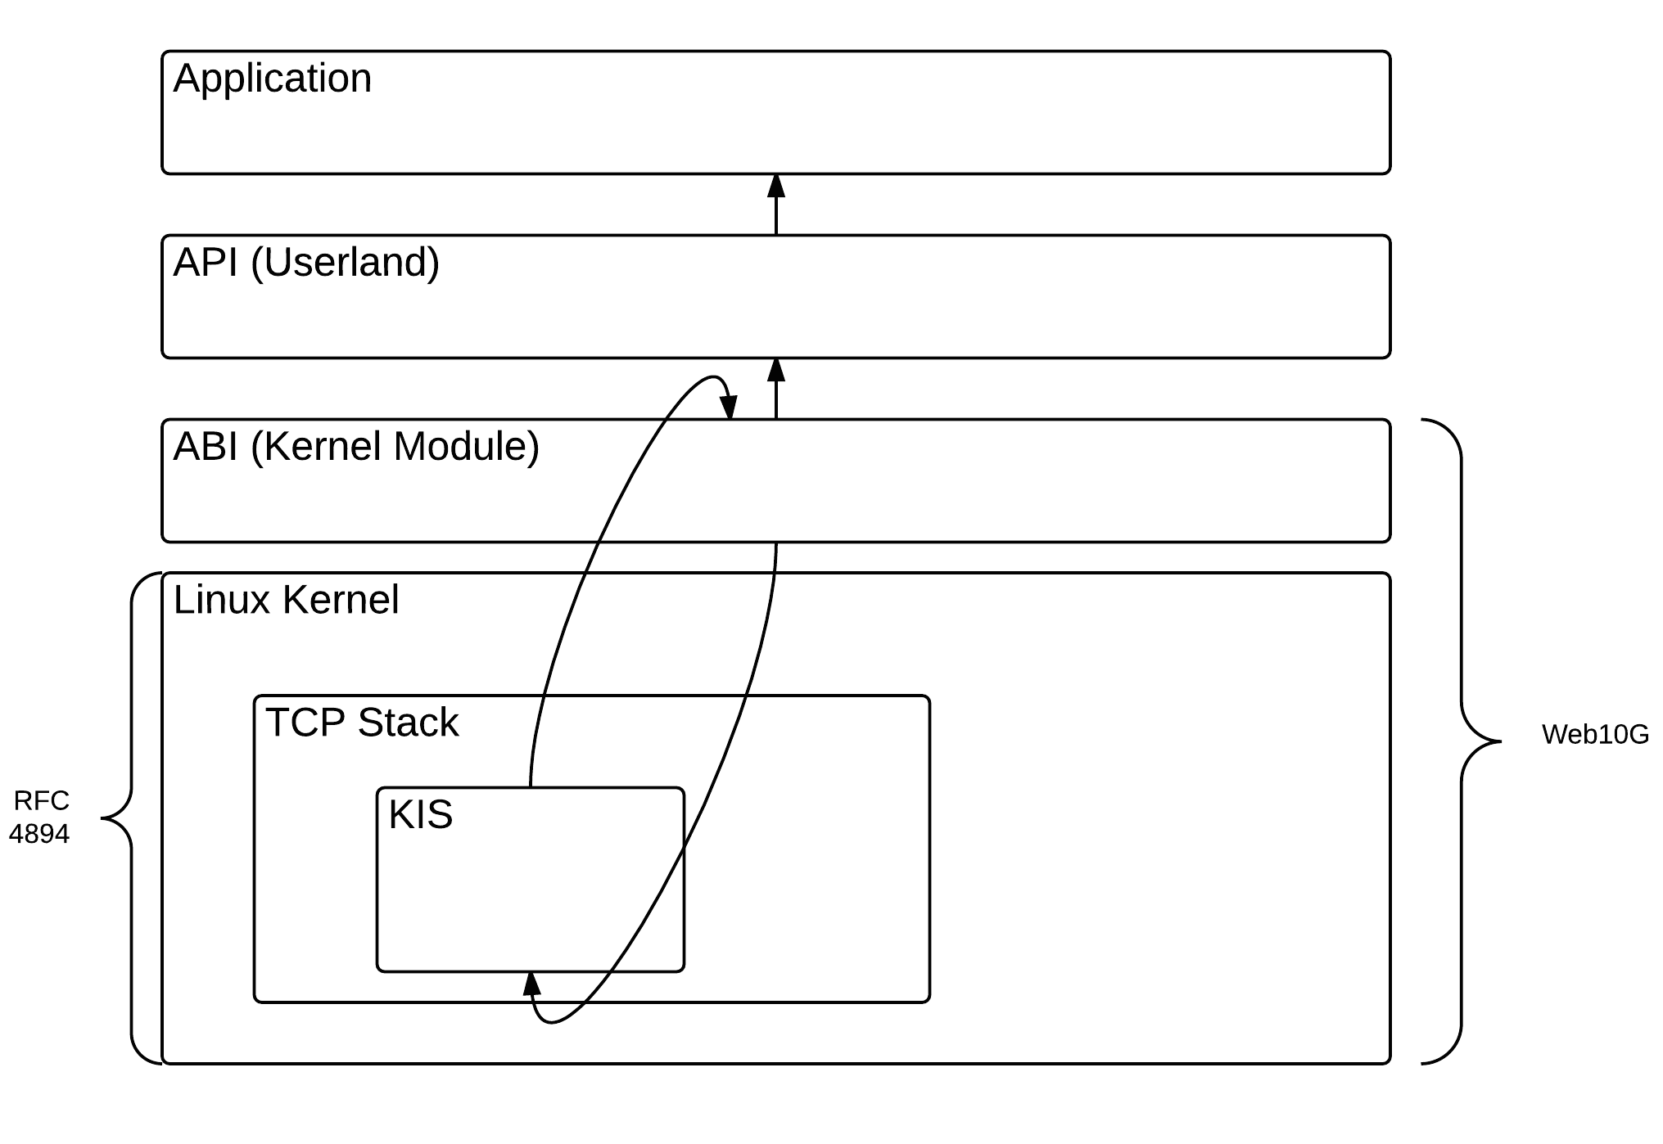
Web10g in Pictures

Slide 9
Why Bother?
More information
Better tools
Deeper insight into usage

Slide 10
The Insight Tool
Three different types of network users
  Those who know, those who expect too much, those who expect too little
  Underutilization is a *real* problem
How do we help those who don’t expect enough?
  Give them a tool to visualize their flows
  Point out poorly performing flows
    Which is a *hard* problem
  Let them easily report problems to the NOC
  Teach them what to expect

Slide 11
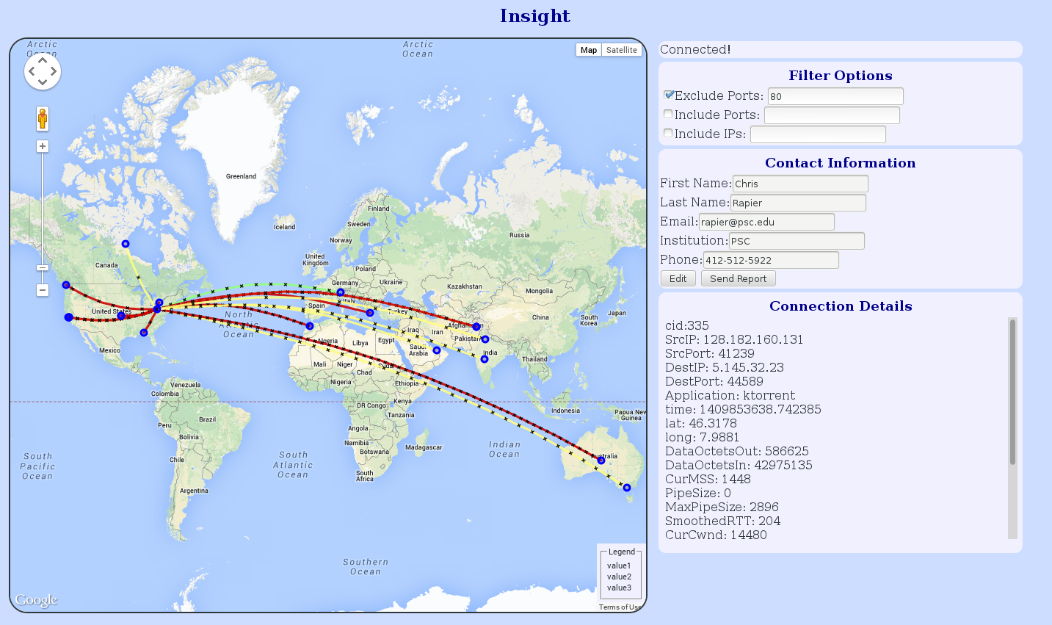
The Insight UI
Notes:
Insight is an application that hooks into a local hosts Web10G metrics by way of a websocket server. The goal is to present the user with a visual weather map of their own connections with the ability to report on failing connections to a NOC automatically. The basic usage scenario assumes that a researcher is transferring data sets to or from their own system. The enable the local insight listener and then navigate to a webpage hosted by their NOC that provides the user interface and control mechanisms for the local listener. By default common user connections (HTTP, IMAP, POP, etc) are filtered so it only shows the network connections of most interest in terms of scientific workflow. The user then has a visual representation of the health of their transfer based on information such as throughput, retransmits, congestion events, and so forth. If the user feels that the connection is not performing adequately they can chose that the NOC receive snapshots of the connection every so often (as defined by the NOC). The NOC would then have a longitudinal record of the metrics of the actual connection in question. With this information a network engineer should be able to achieve a deeper understanding of why that connection is failing in context of the user.
Of course, this does depend on the user having a Web10G enabled kernel. This should not be as much of a problem once Web10G is adopted by Linux mainline. Later versions of Insight will have the ability to monitor 3rd party transfers (GridFTP) by having the client reside directly on the transfer hosts in the Science DMZ.

Slide 12
The Insight client
Simple websocket server that monitors flows
Accepts commands in JSON format
  Stacked filters allow for fine tuning of the returned data
    Filter on destination IP/mask, ports, and applications
    Metric mask to limit results to specific data points
Reports returned in JSON format
Not tied to a specific UI.
  Can be used as a base for other monitoring projects
Can return reports directly to a RDBMS

Slide 13
The Insight NOC Tool
Give NOCs an easy entry point into reported flow data
Still barebones at the moment
  Currently can find a view data in a table format
  Hoping to add:
    Reporting
    Advanced search
    Some level of data visualization
      Particularly to show change over life of flow

Slide 14
Insight in Action
Your patience please while we load the demo

Slide 15
Next Steps for Insight
Insight tool is still too limited for most users
  Dependencies create large barriers to entry
  Cannot monitor 3rd party transfers
  Still requires users to *watch* the flow
Solution: Install in DMZs to monitor scheduled transfers
  Provide a UI to the NOC with better alarming
    This would include reporting and analysis to find trends
  Give users access to real time visualization or post transfer reports in plain language
    Authorization is going to be hard but doable.

Slide 16
Status of Web10g
Core code is stable and deployable
Working with teams at Google to prepare for submission to Linux kernel
Tool development is on going
http://www.web10g.org
http://github.com/rapier1/web10g
rapier@psc.edu

